Slide 1
SZCZECIN INTERNATIONAL SCHOOL
EVENTS AND ACHIEVEMENTS
2nd SEMESTER OF THE SCHOOL YEAR 2021/2022

Slide 2
FEBRUARY, MARCH, APRIL activities

Slide 3
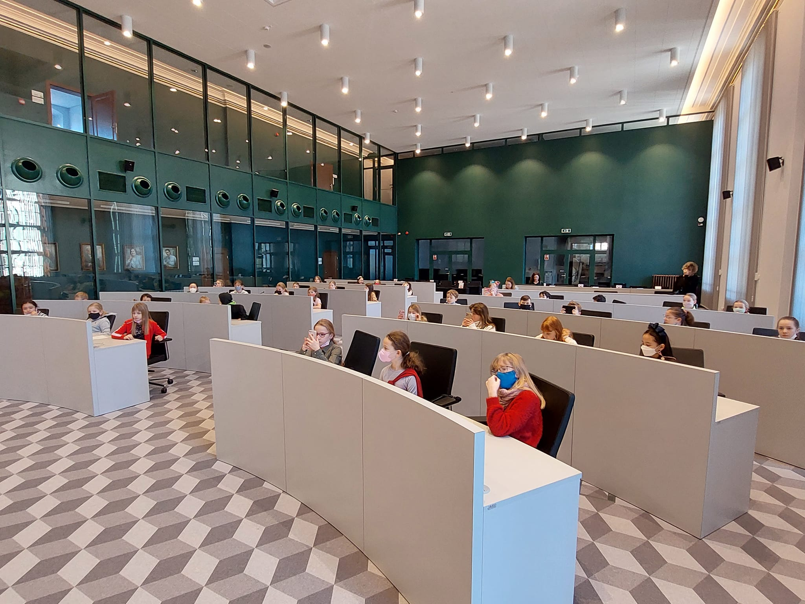
CITY HALL PYP

Slide 4
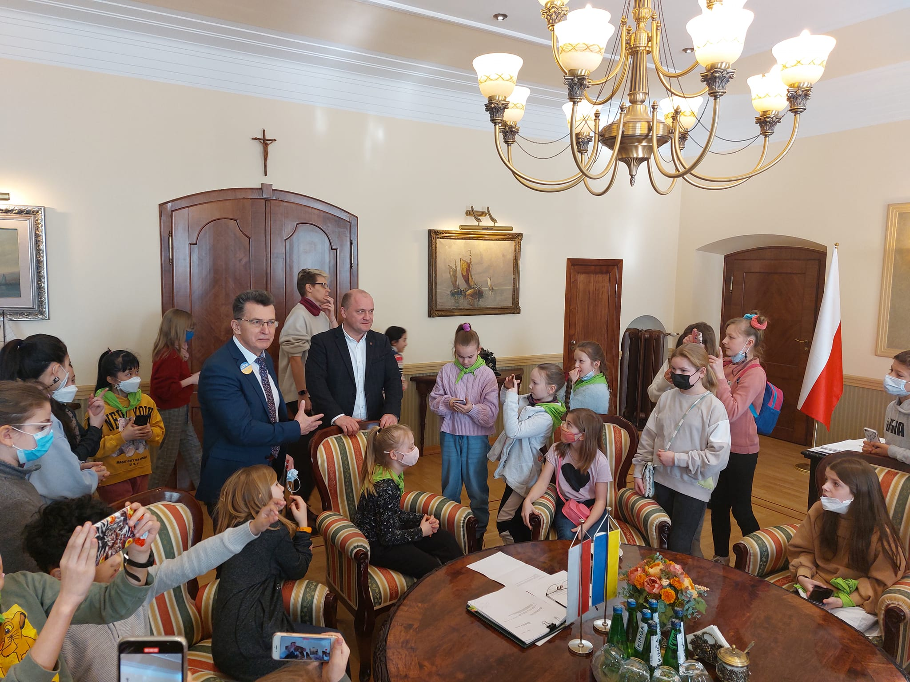
Meeting with PRESIDENT OF SZCECIN, Piotr krzystek

Slide 5
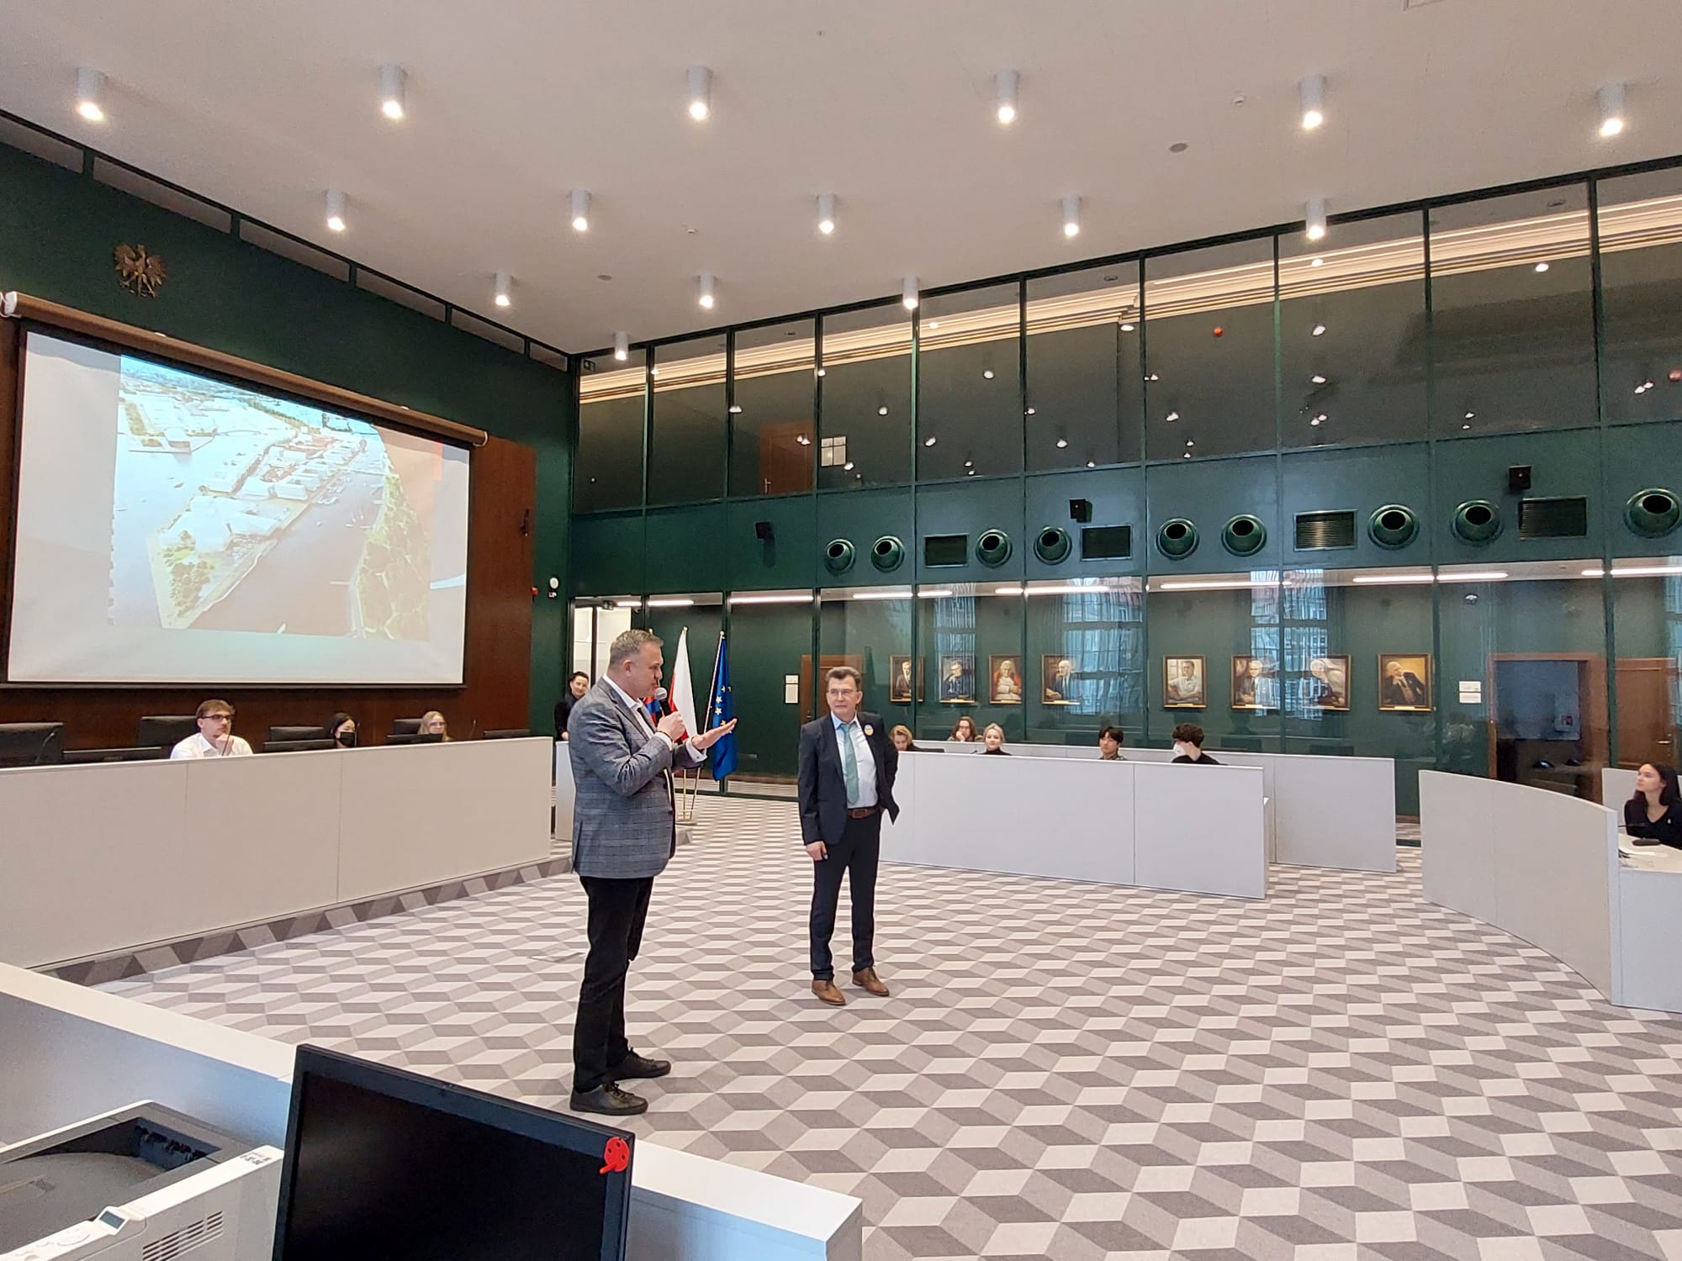
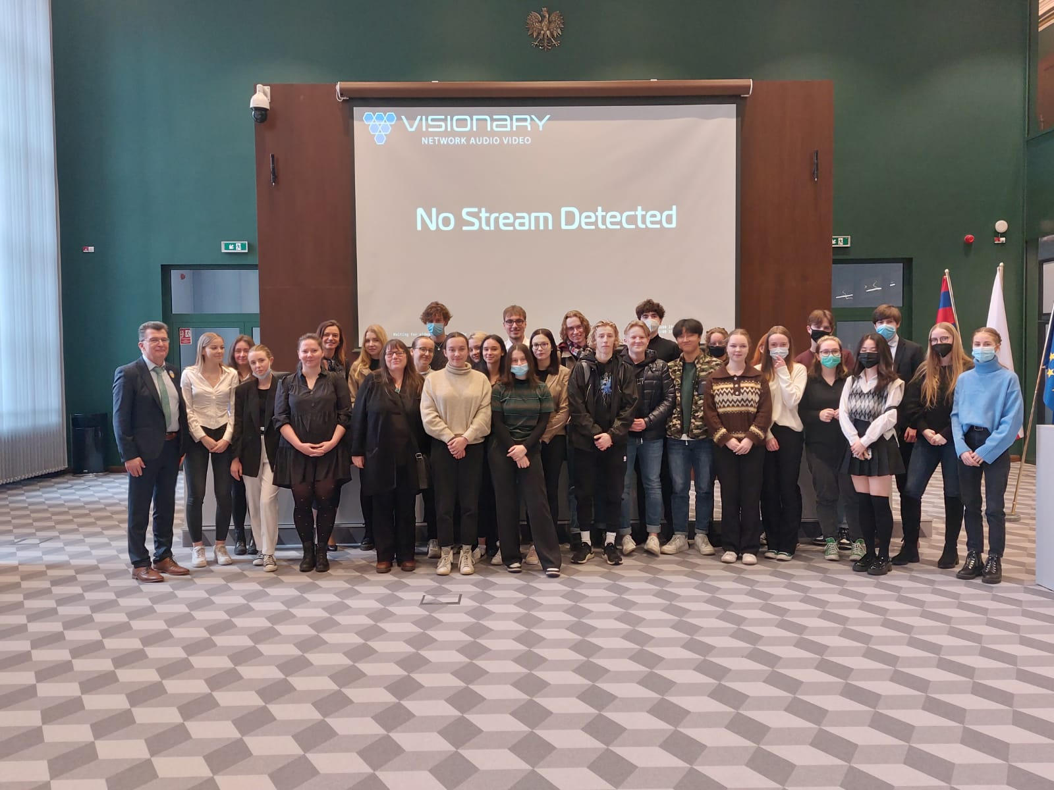
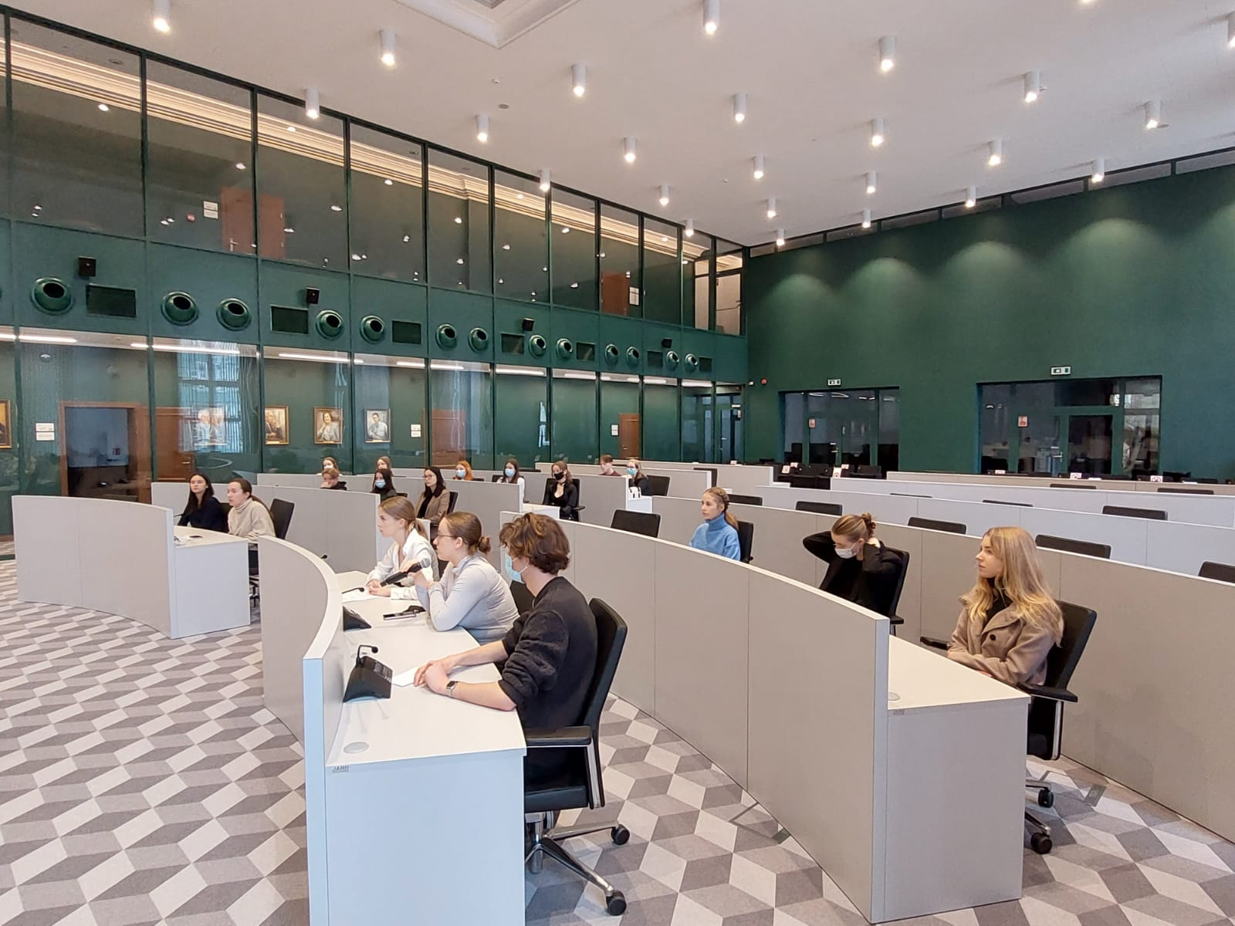
CITY HALL DP MEETING WITH MR K.SOSKA AND Mr m. żylik

Slide 6
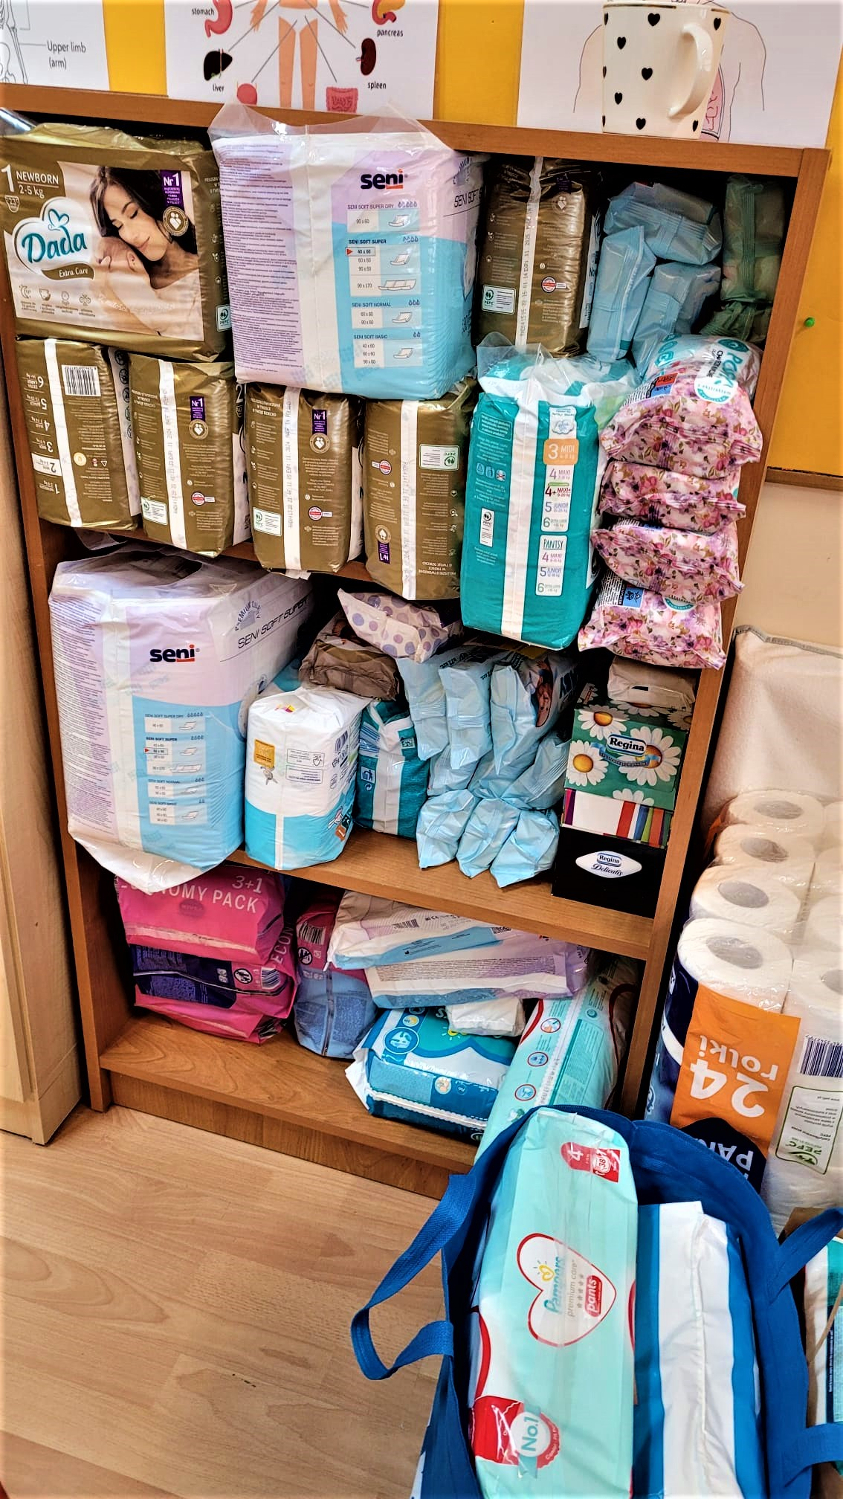
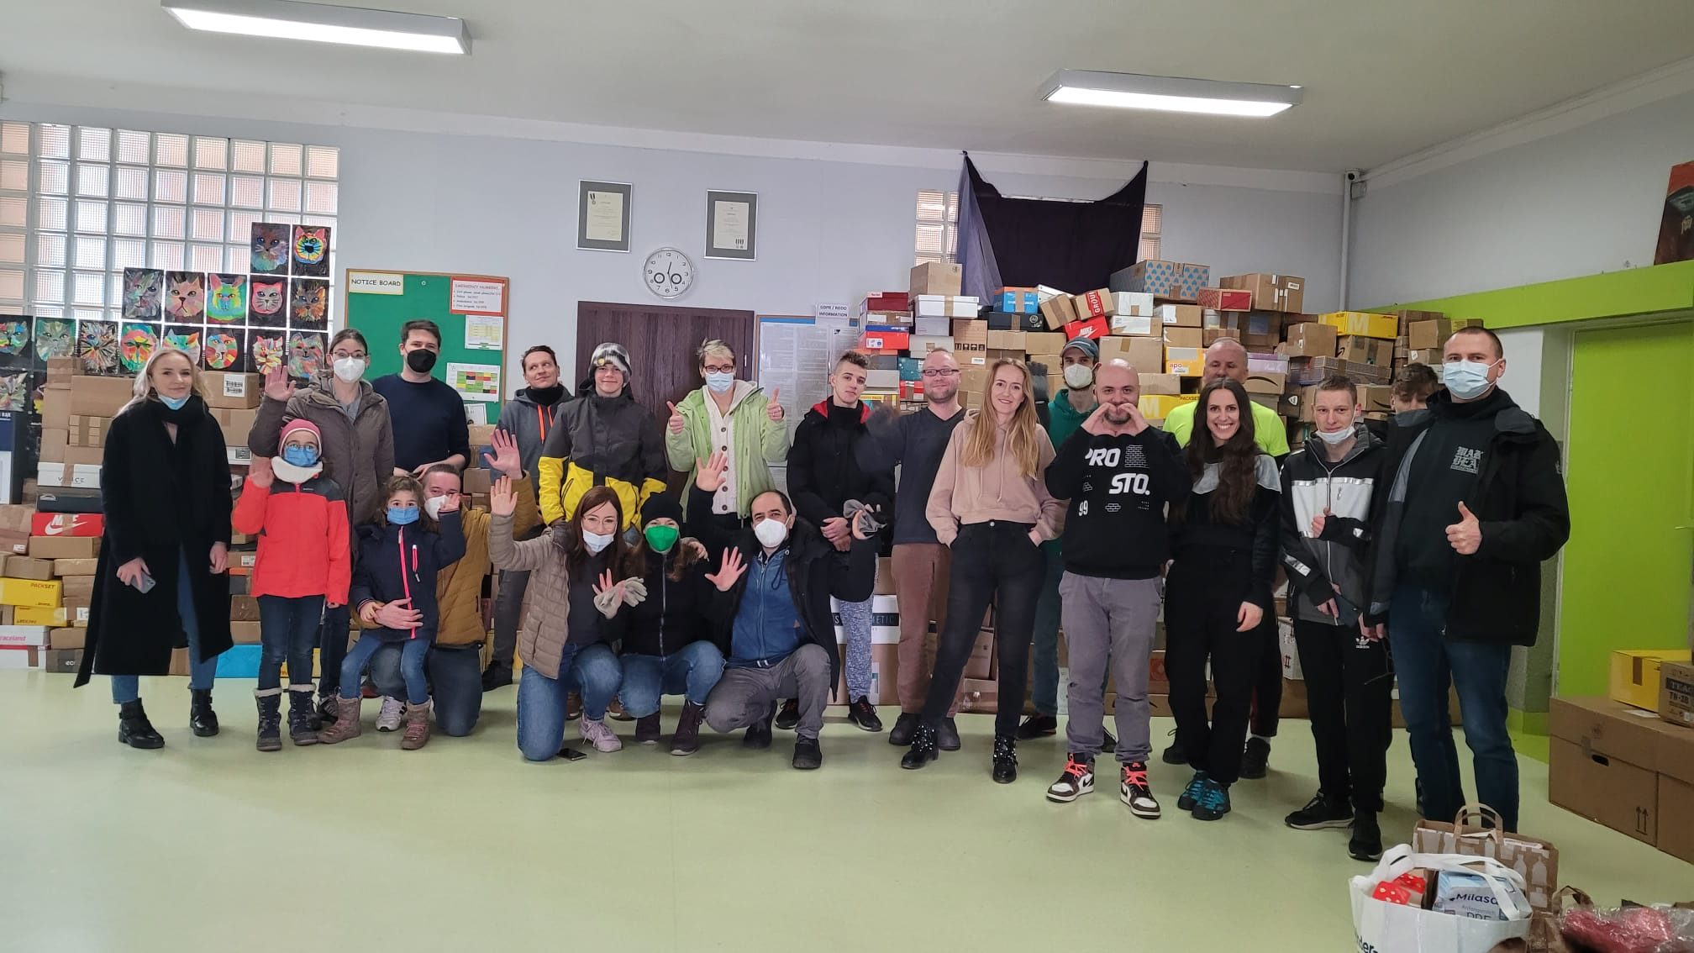
OUR BIG HEARTS FOR UKRAINE

Slide 7
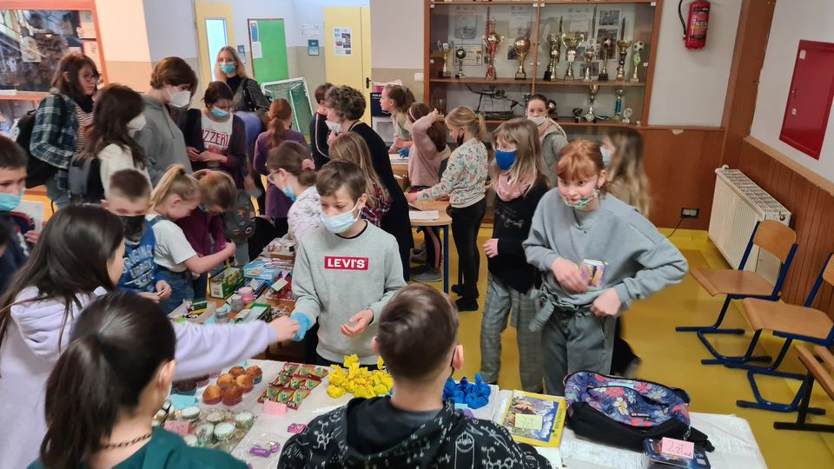
OUR BIG HEARTS FOR UKRAINE

Slide 8
BAKE SALE

Slide 9
OPEN CLASS – SIS FOR UKRAINE
M.Wesołowska-Nowak, E.Karczewska, M.Polakowska, M.Nizińska

Slide 10
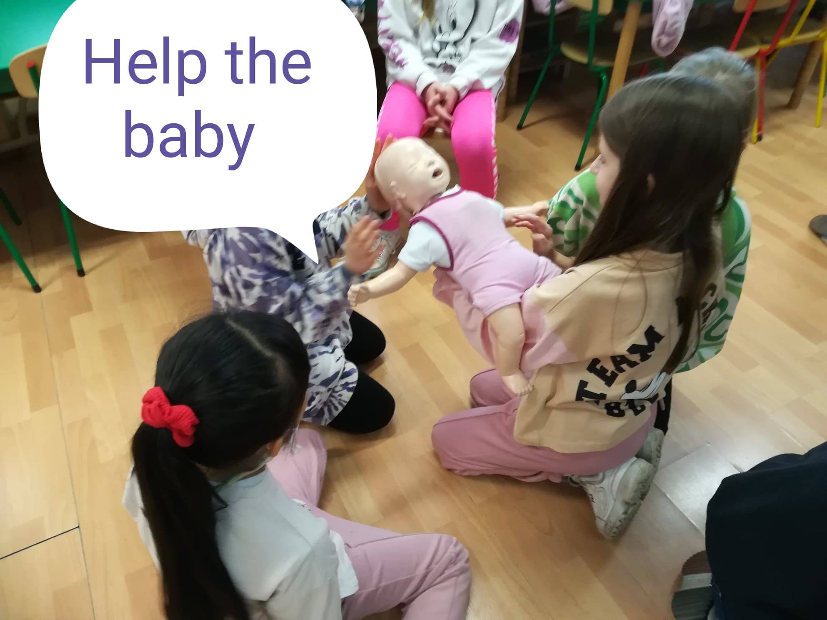
FIRST AID WORKSHOP-G3

Slide 11
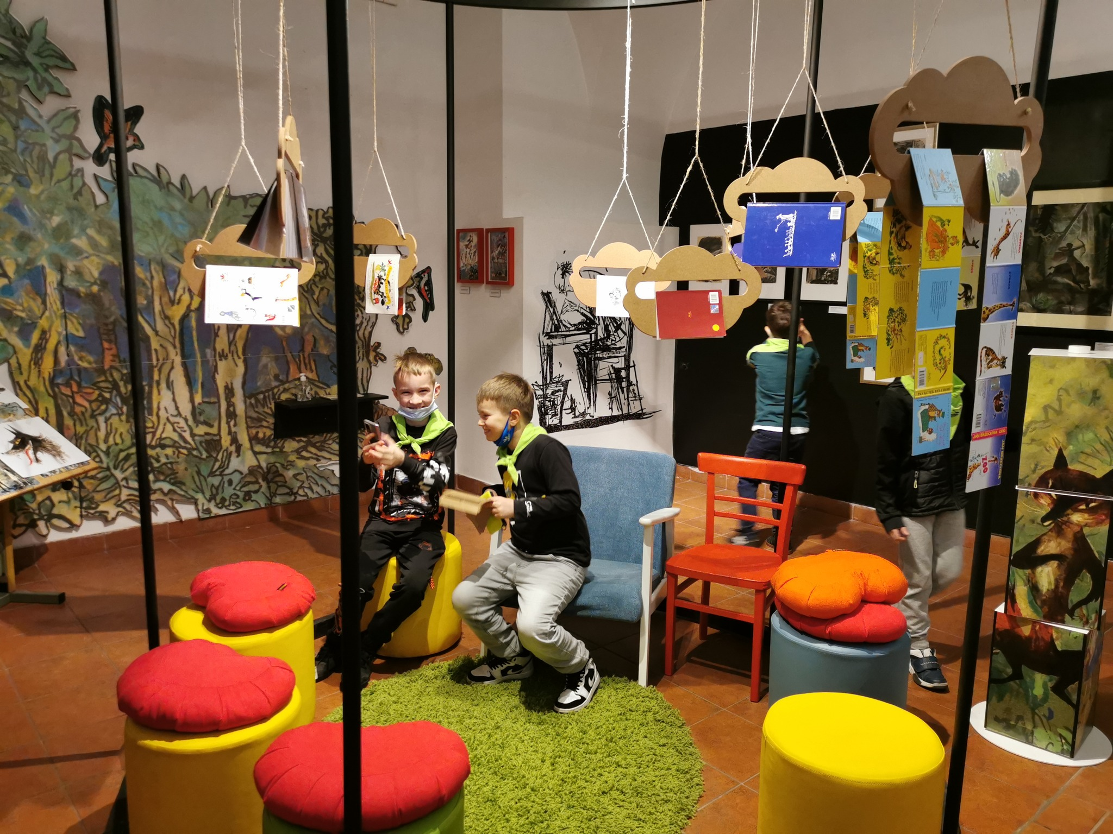
G2 IN THE POMERANIAN DUKE’S CASTLE
Organiser: A.Lal

Slide 12
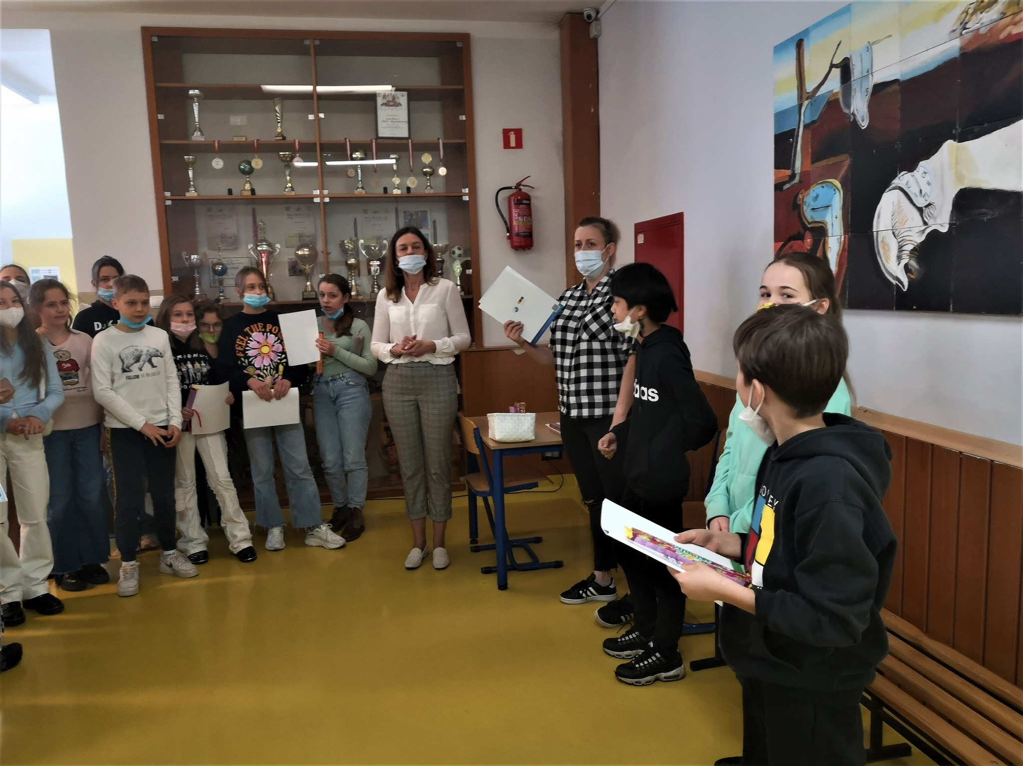
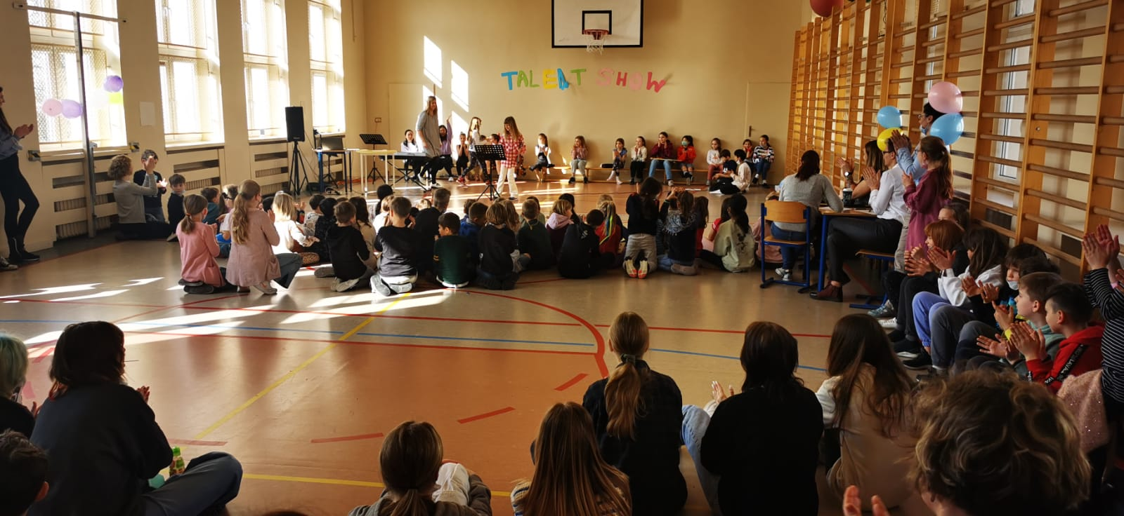
TALENT SHOW
Organiser: M.Nizińska

Slide 13
POETRY CONTEST
Organisers:
M.Wesołowska-Nowak,
M. Lechicka-Dziel

Slide 14
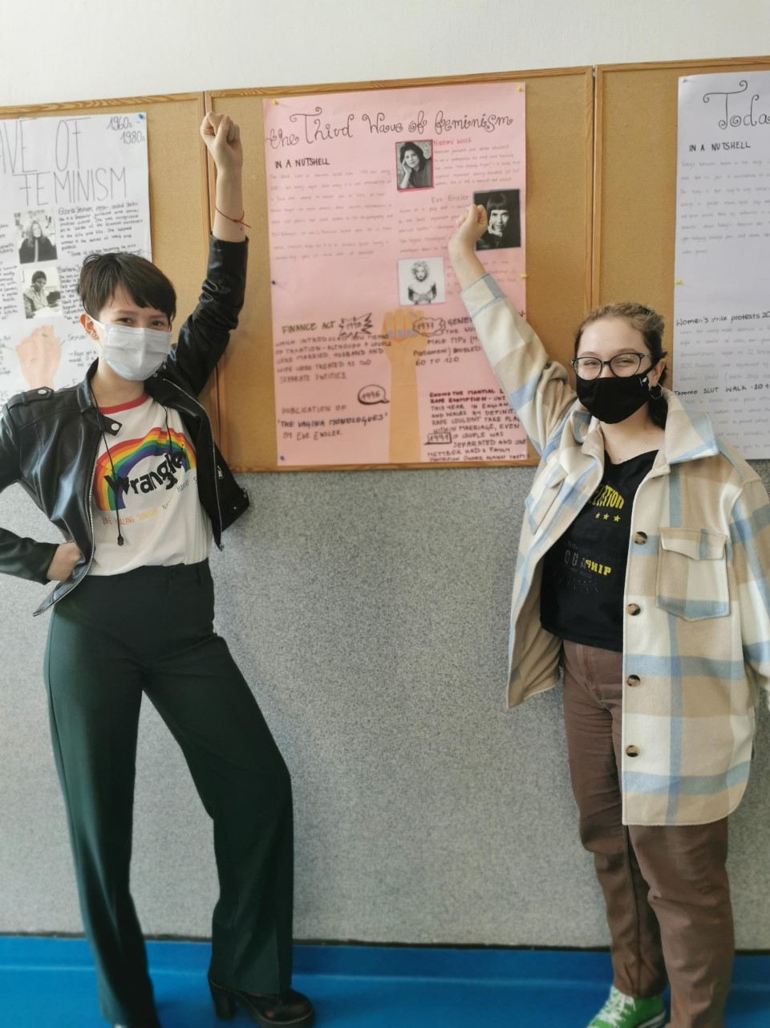
WOMEN’S DAY EXIBITION

Slide 15
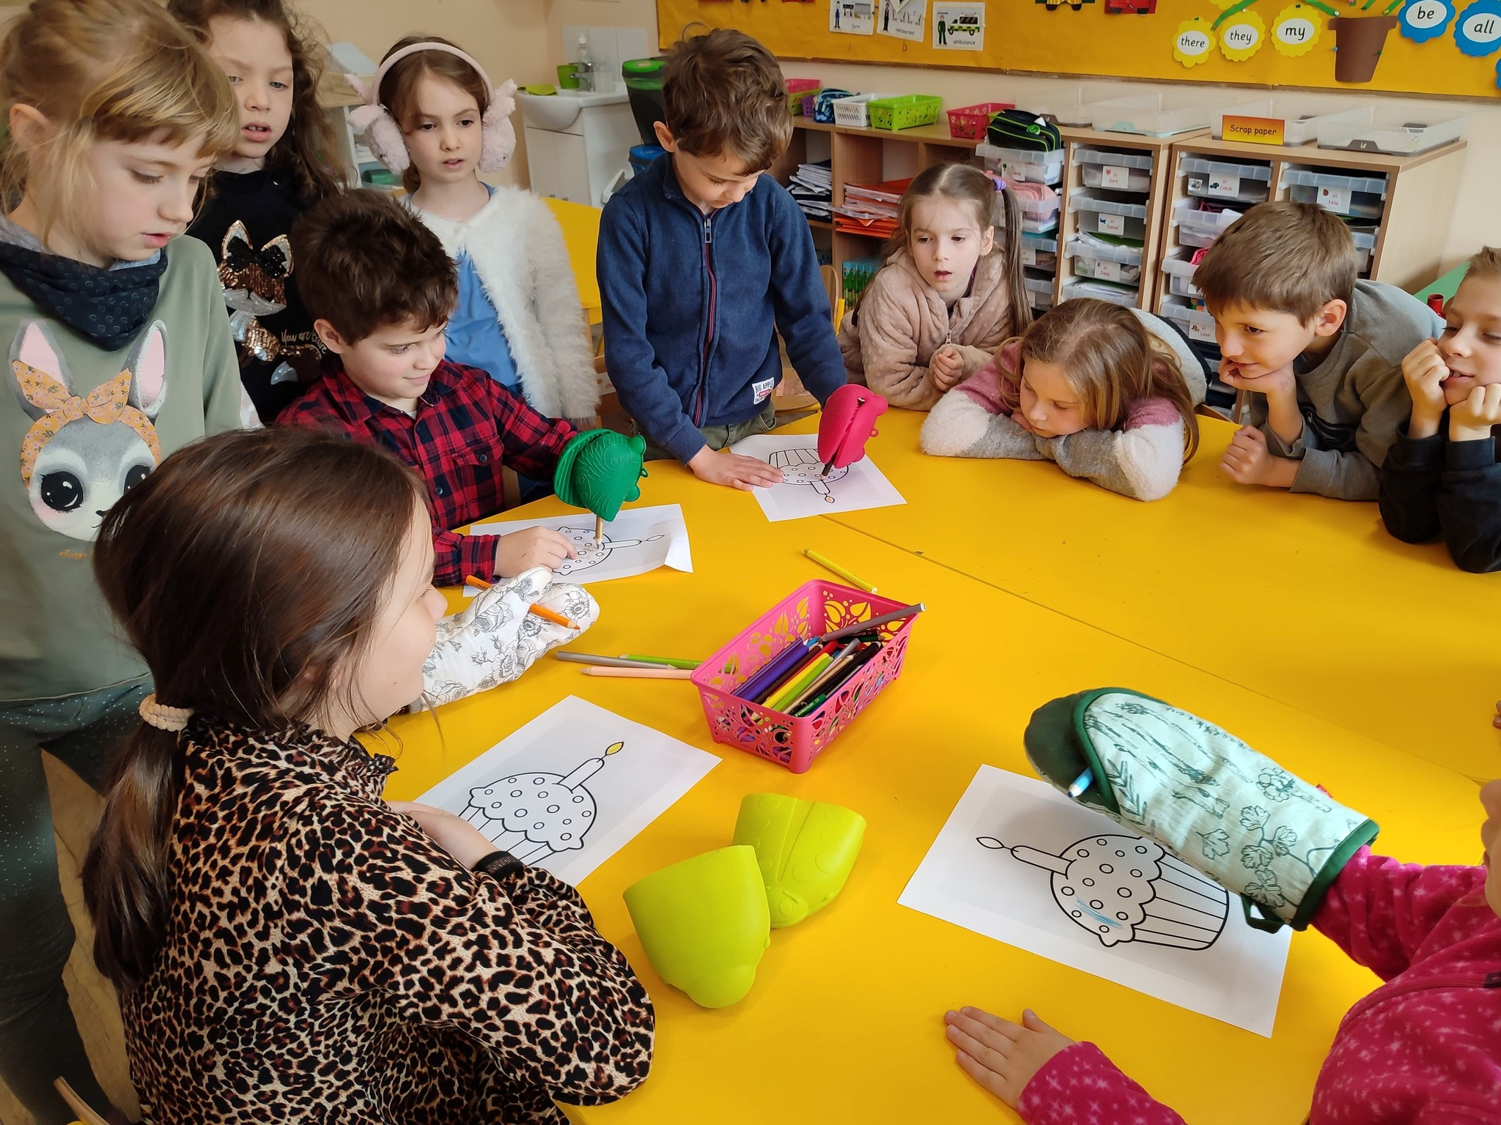
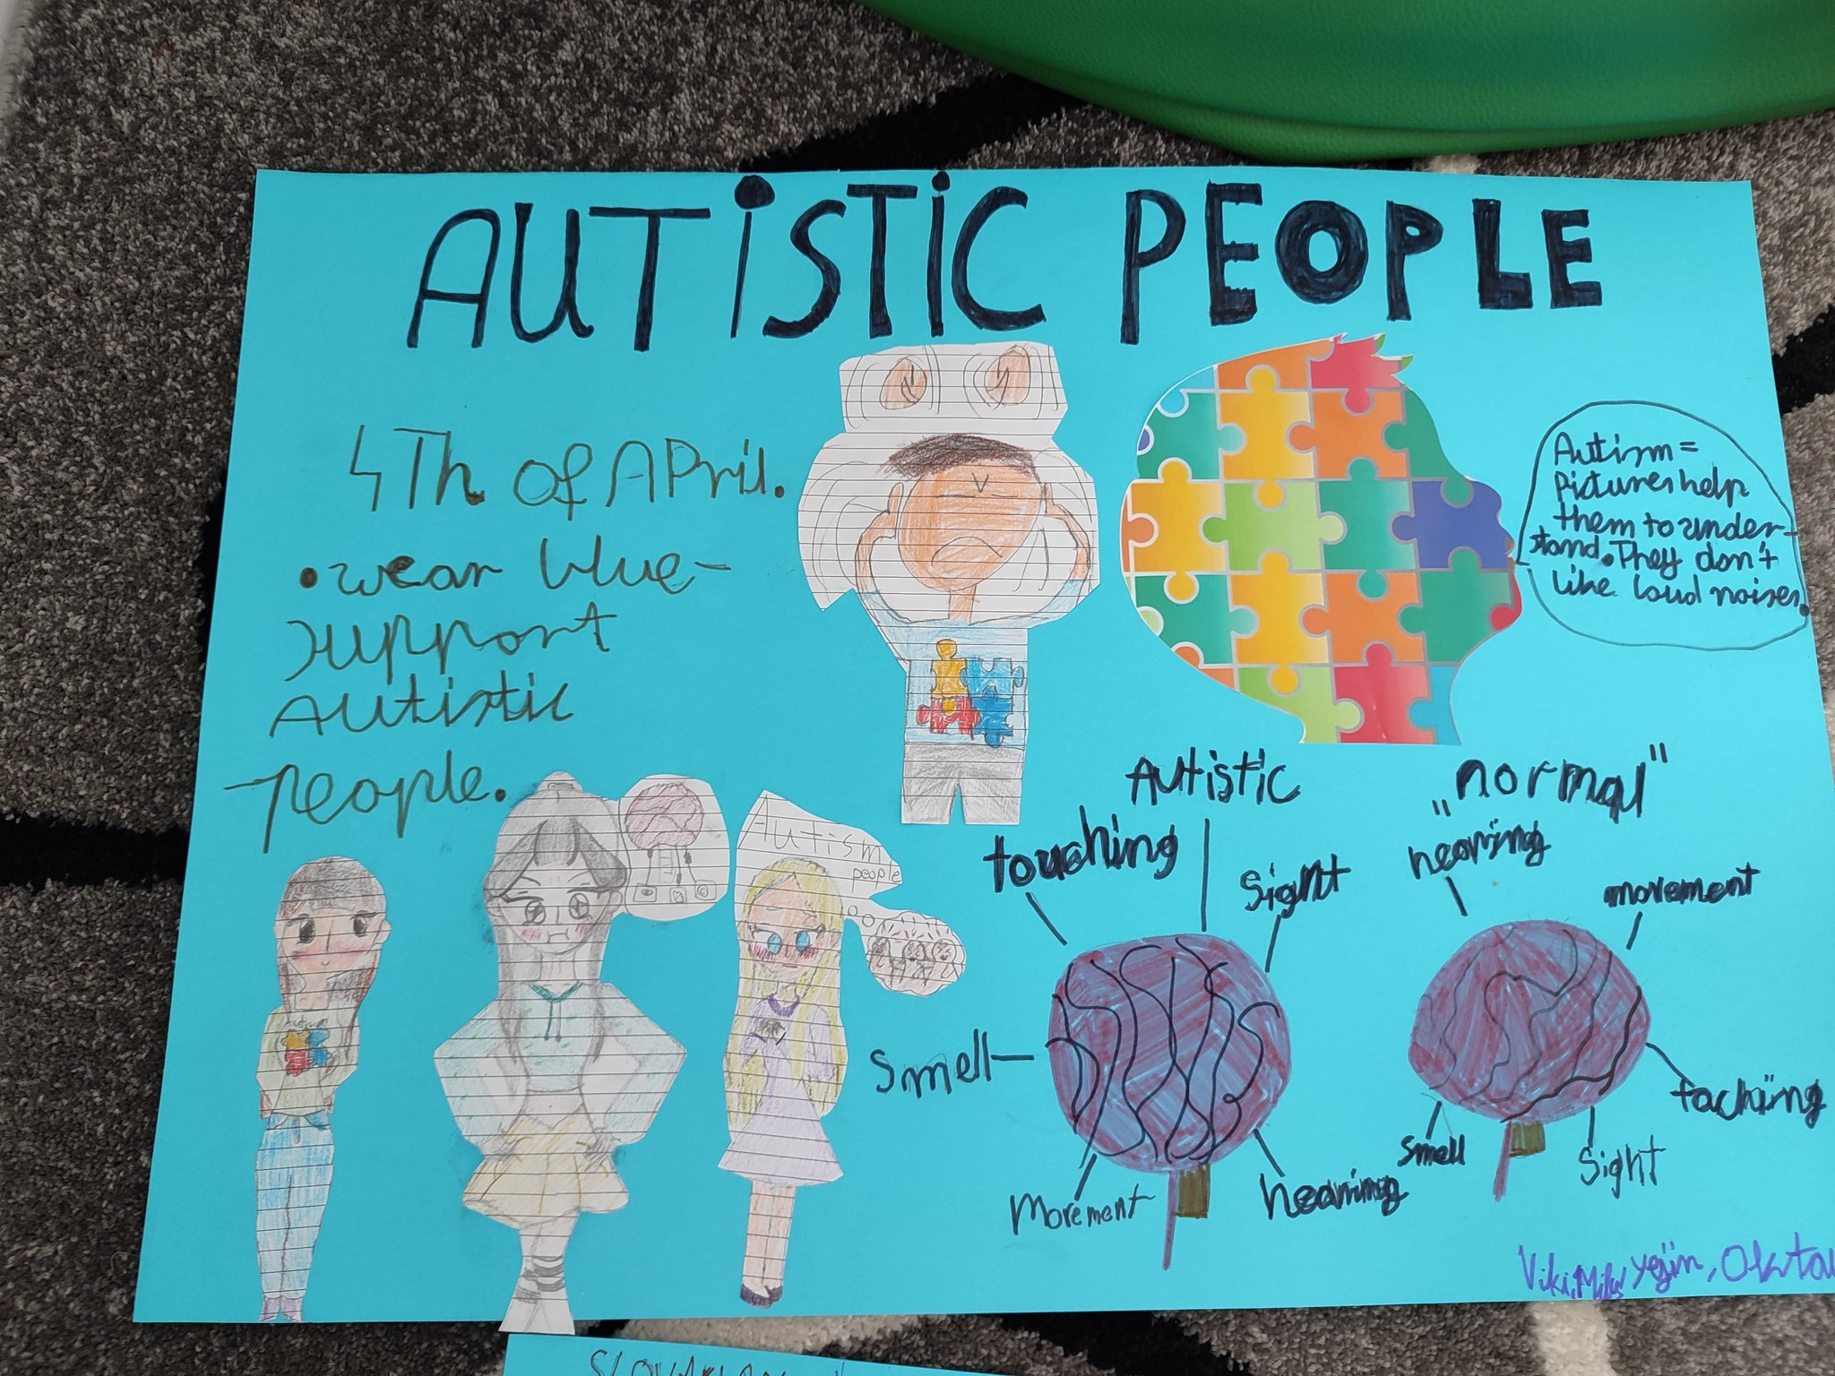
WORLD AUTISM AWARENESS DAY
Organiser: L.Podporska

Slide 16
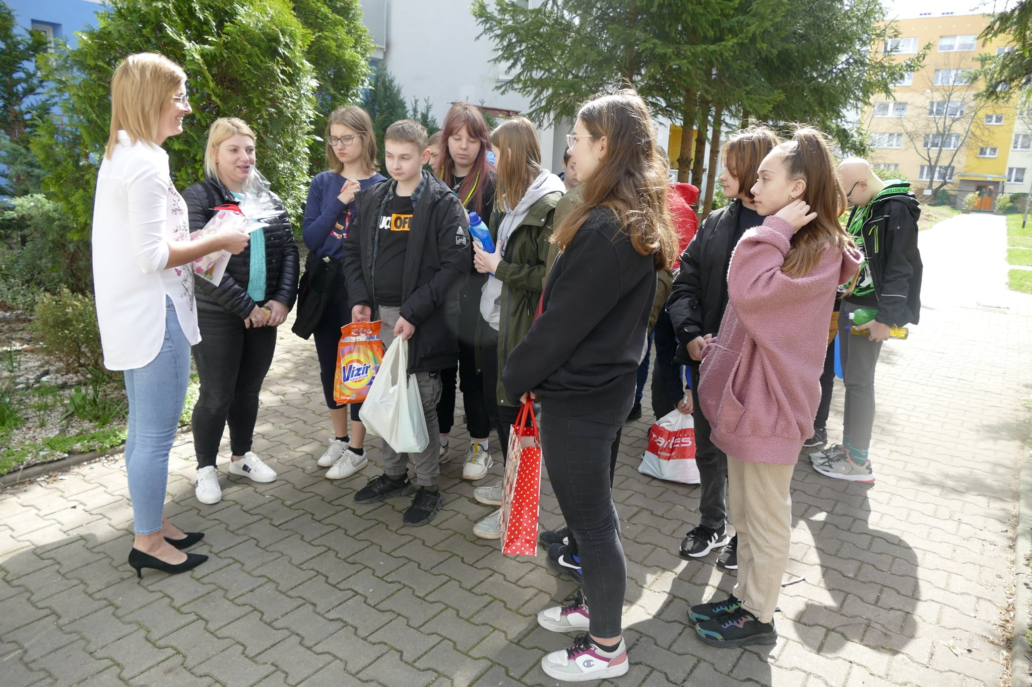
Easter - DOM KOMBATANTA
Organiser: M. Polakowska

Slide 17
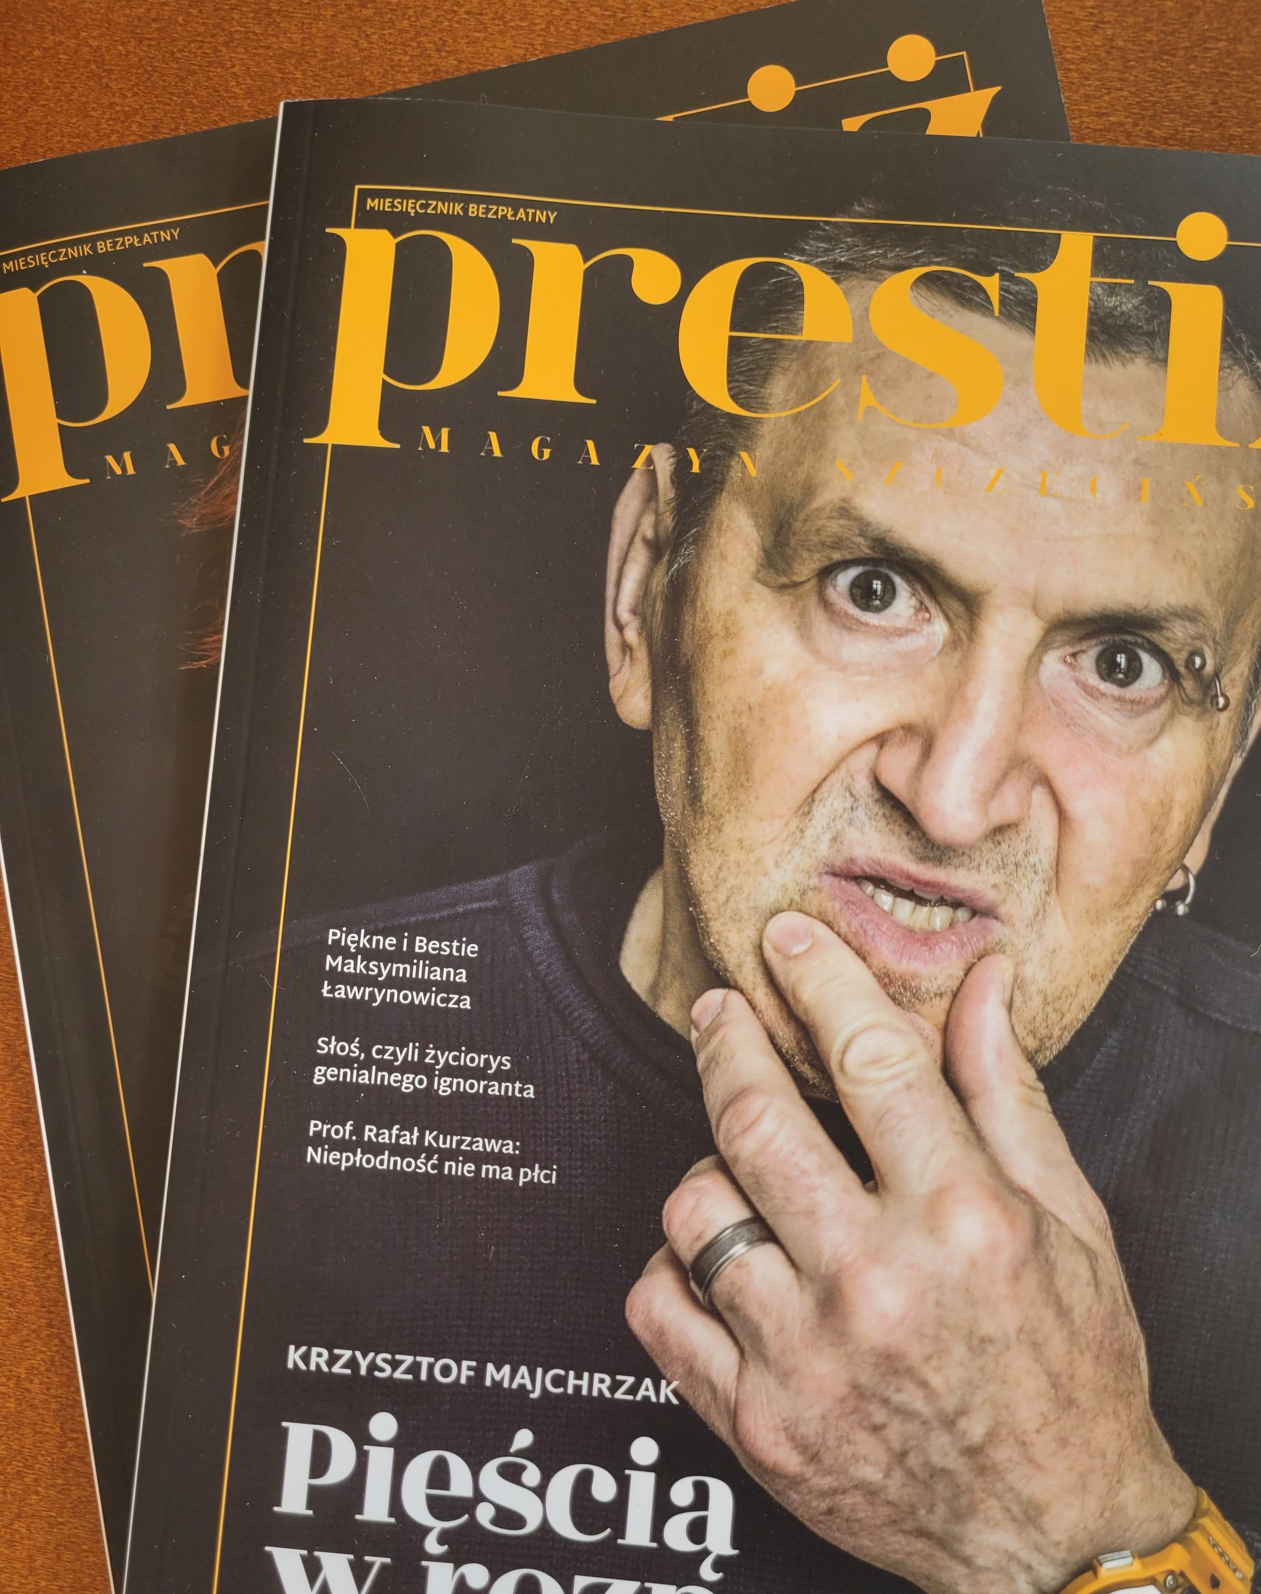
PRESTIŻ MAGAZINE
M.WESOŁOWSKA-NOWAK
A.PŁUCIENNIK
E.KARCZEWSKA

Slide 18
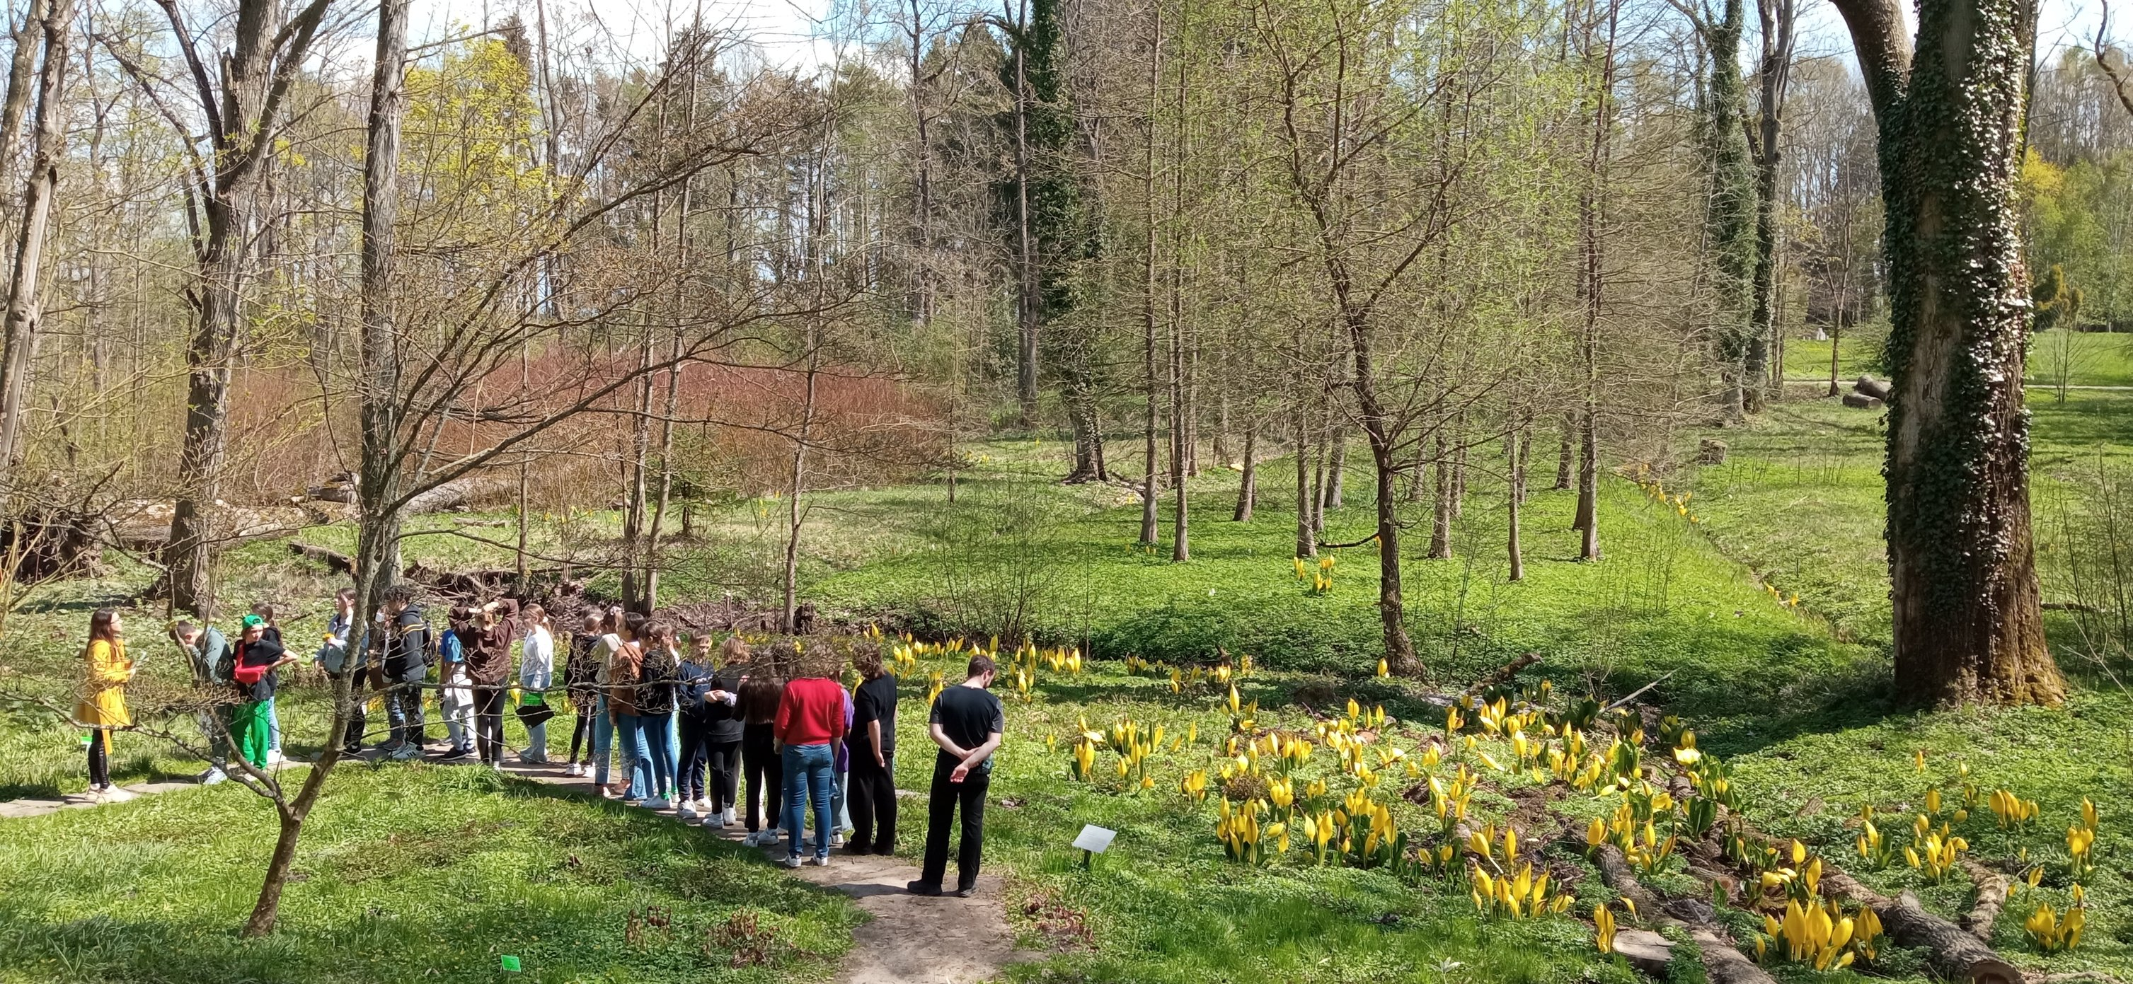
ECO DAY IN PRZELEWICE - MYP
Organiser: A.Maruszak

Slide 19
MYP VOLLEYBALL CHAMPIONSHIP
Organiser: C. Janiszyn

Slide 20
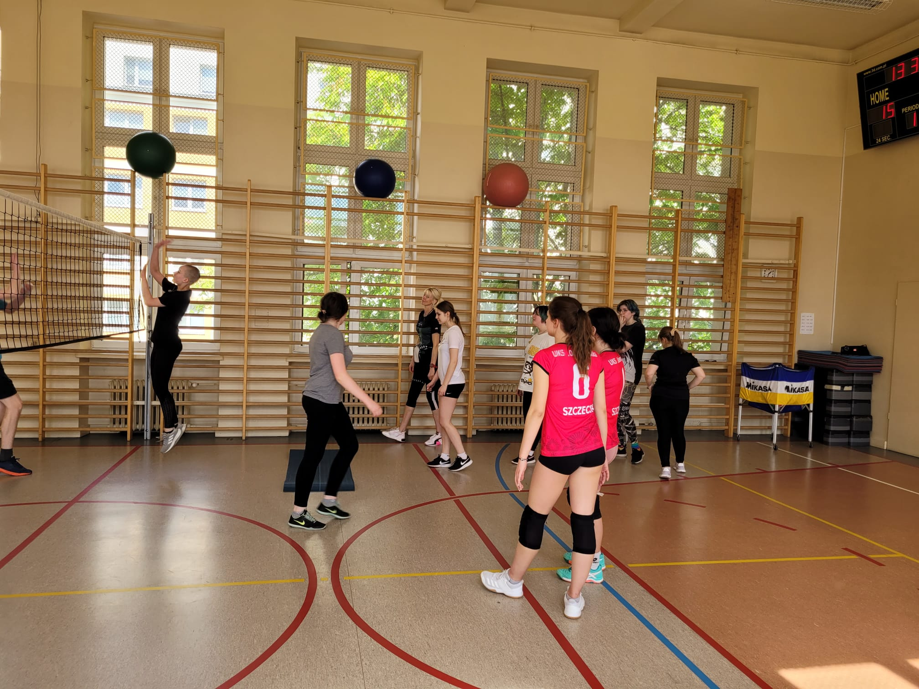
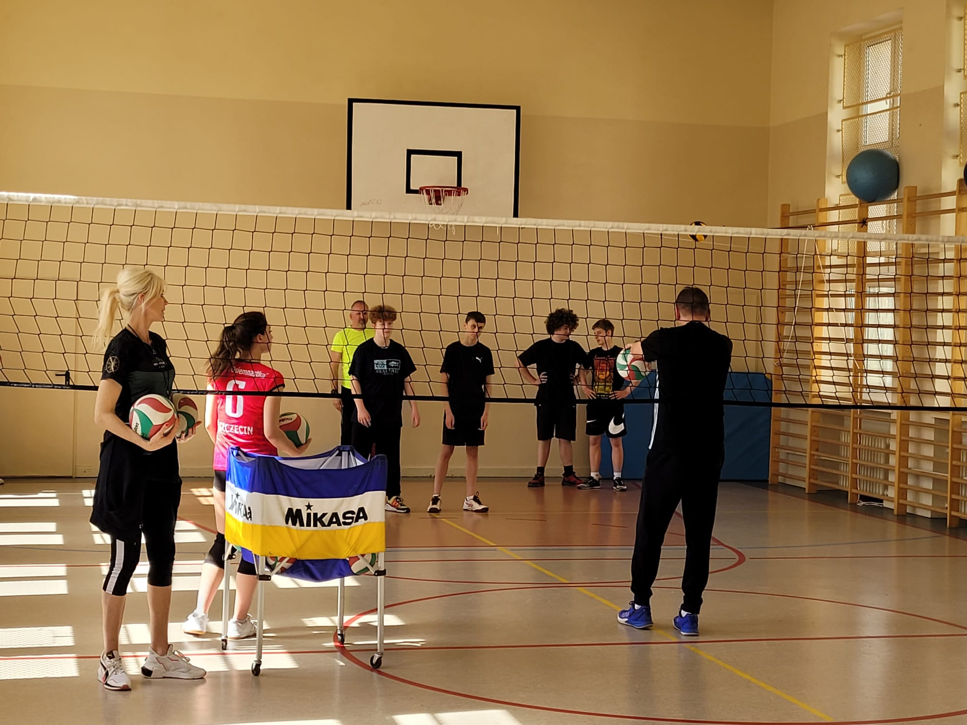
VOLLEYBALL TRAINING WITH UKS „OSIEMNASTKA”
E.CZAJKOWSKA

Slide 21
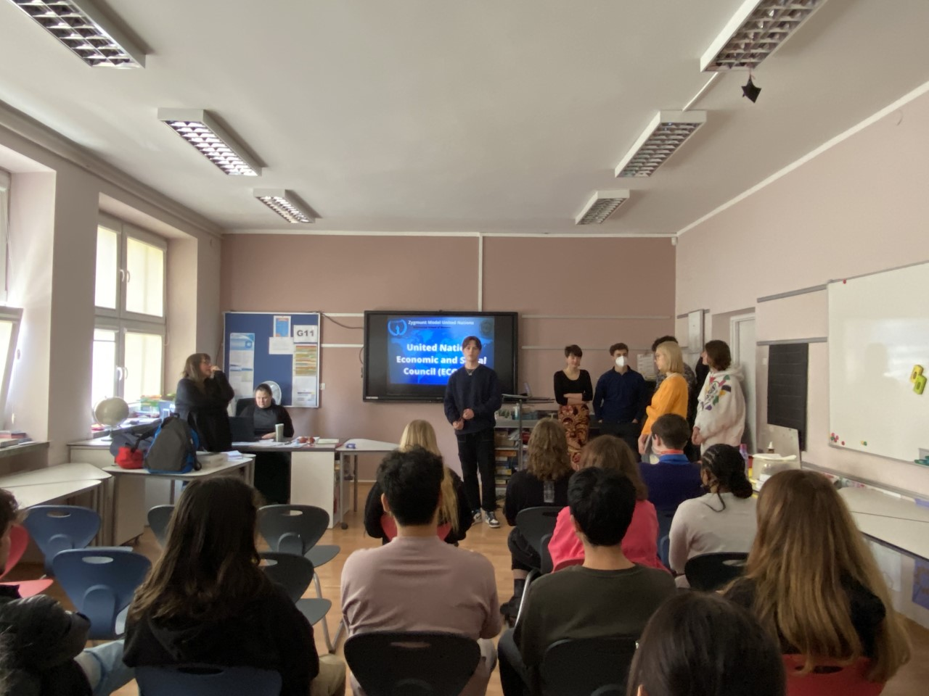
ZYGMUN
D.Howlett

Slide 22
MAY, JUNE activities

Slide 23
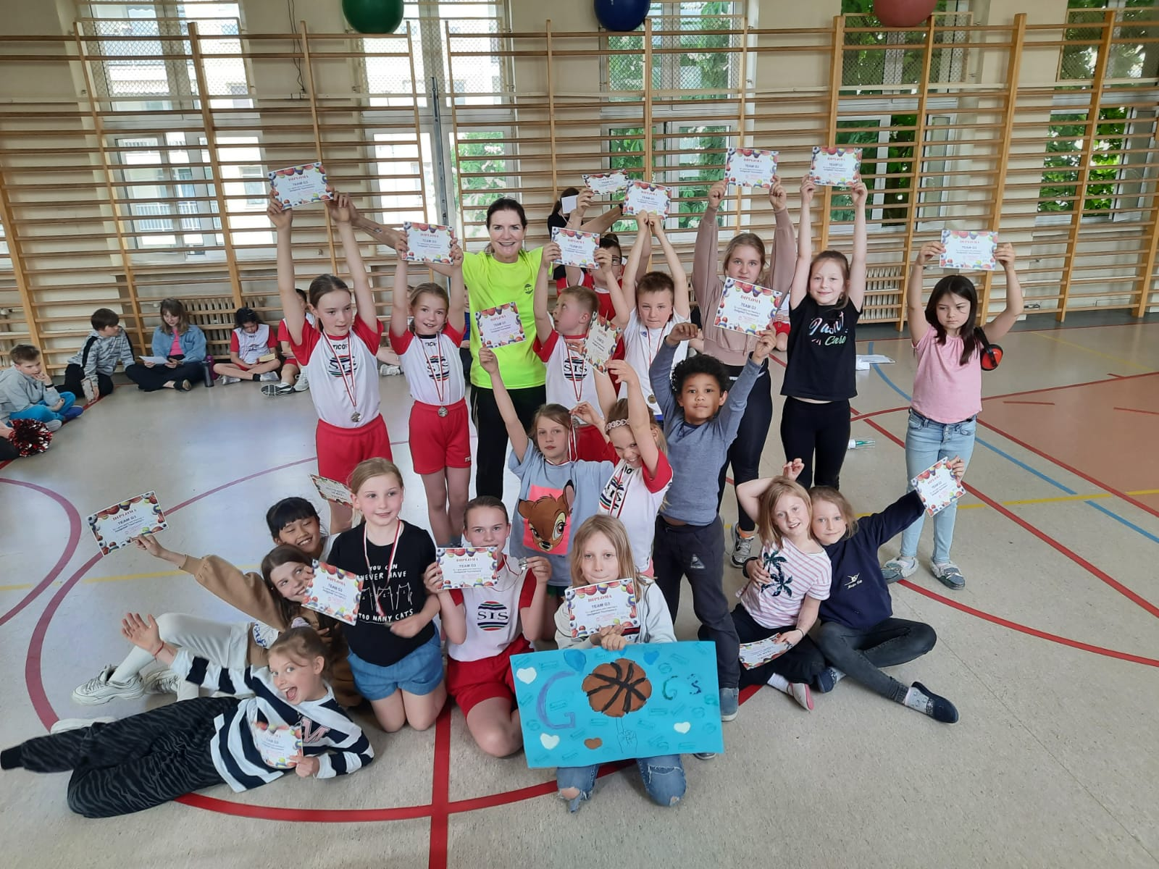
Dodgeball tournament for G3-G5

Slide 24
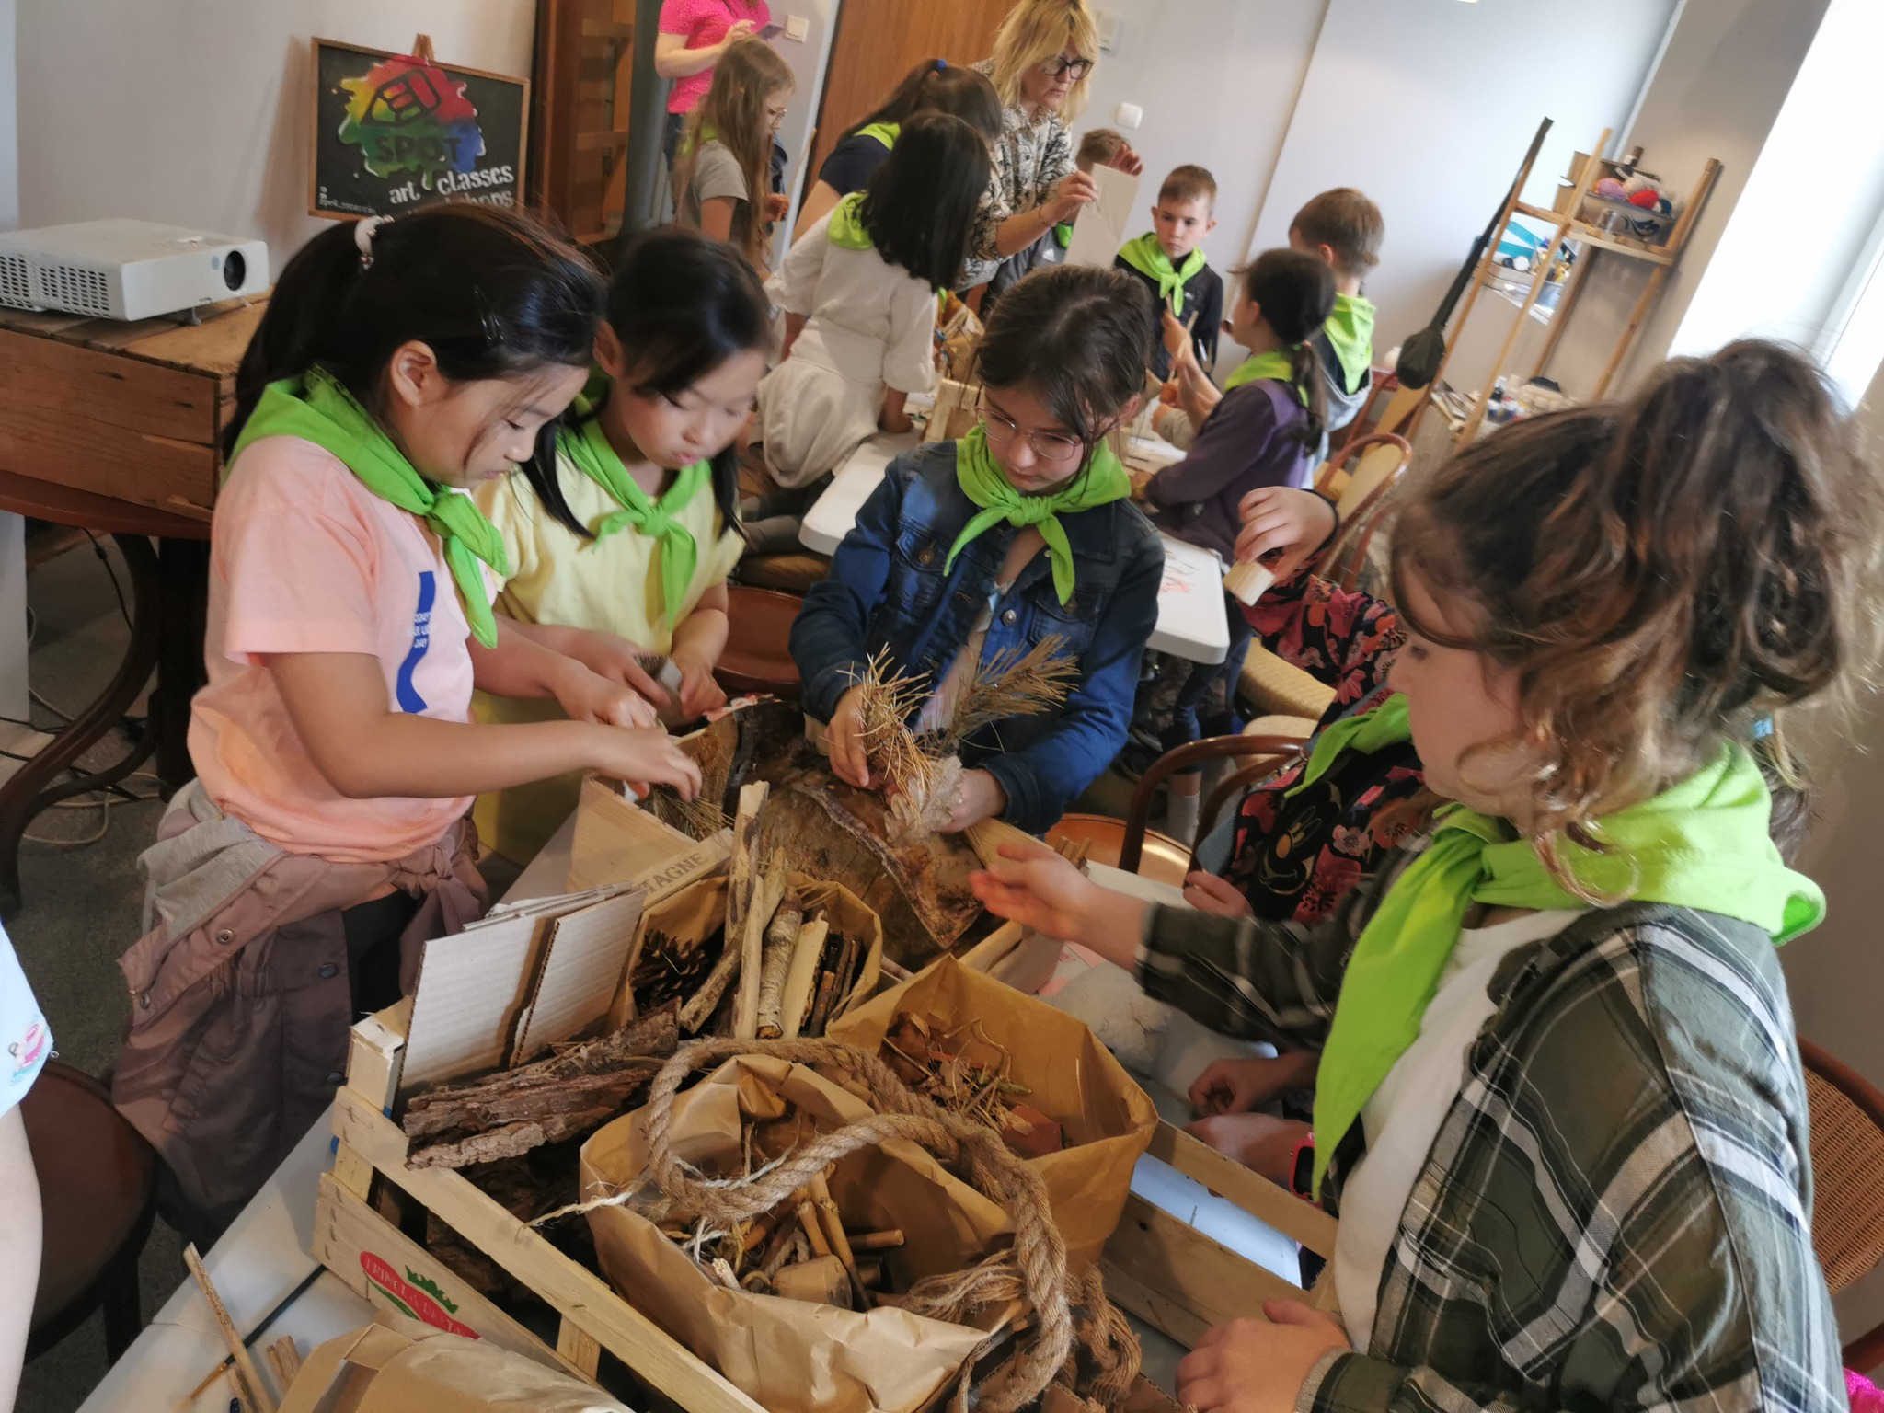
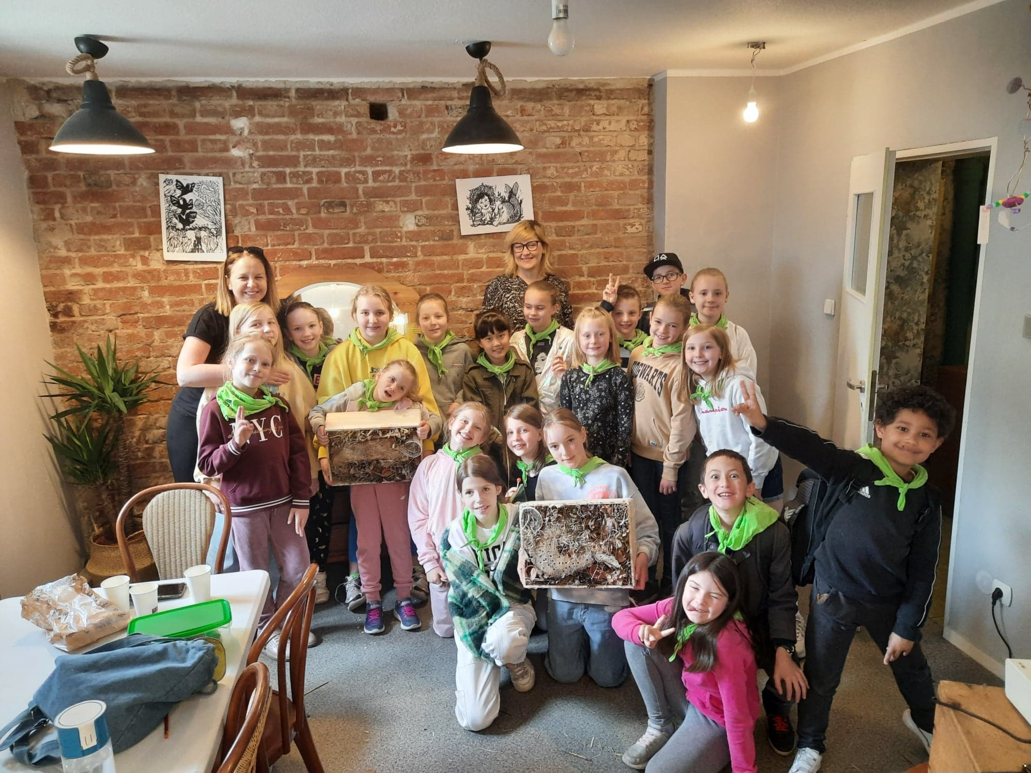
workshops at SPOT center - G 2,G 3
Organisers: A.Lal, M.Perrot

Slide 25
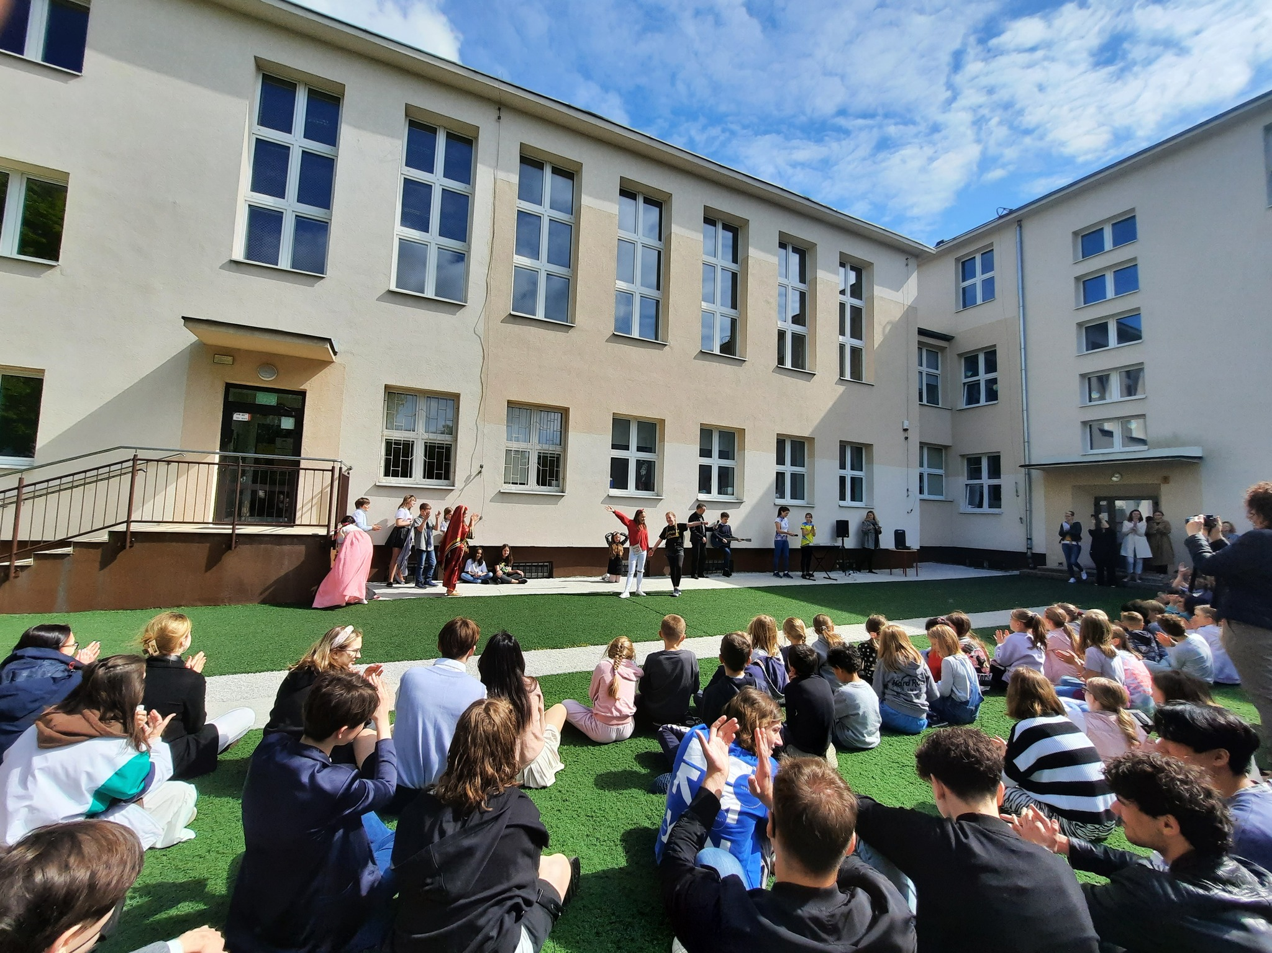
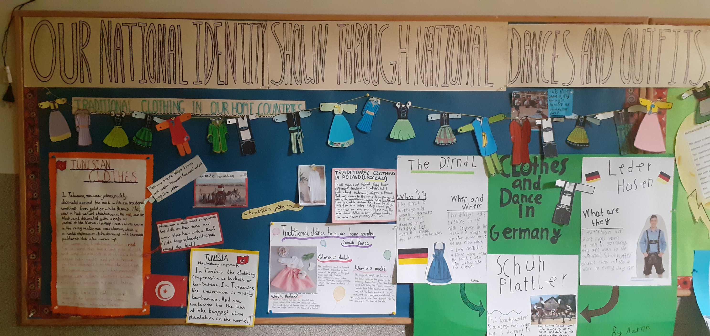
Pyp exibition-g 5
Organisers:
A.Piórkowska,
K.Kmiecik
Mentors:
A.Collins,
A.Witkowska

Slide 26
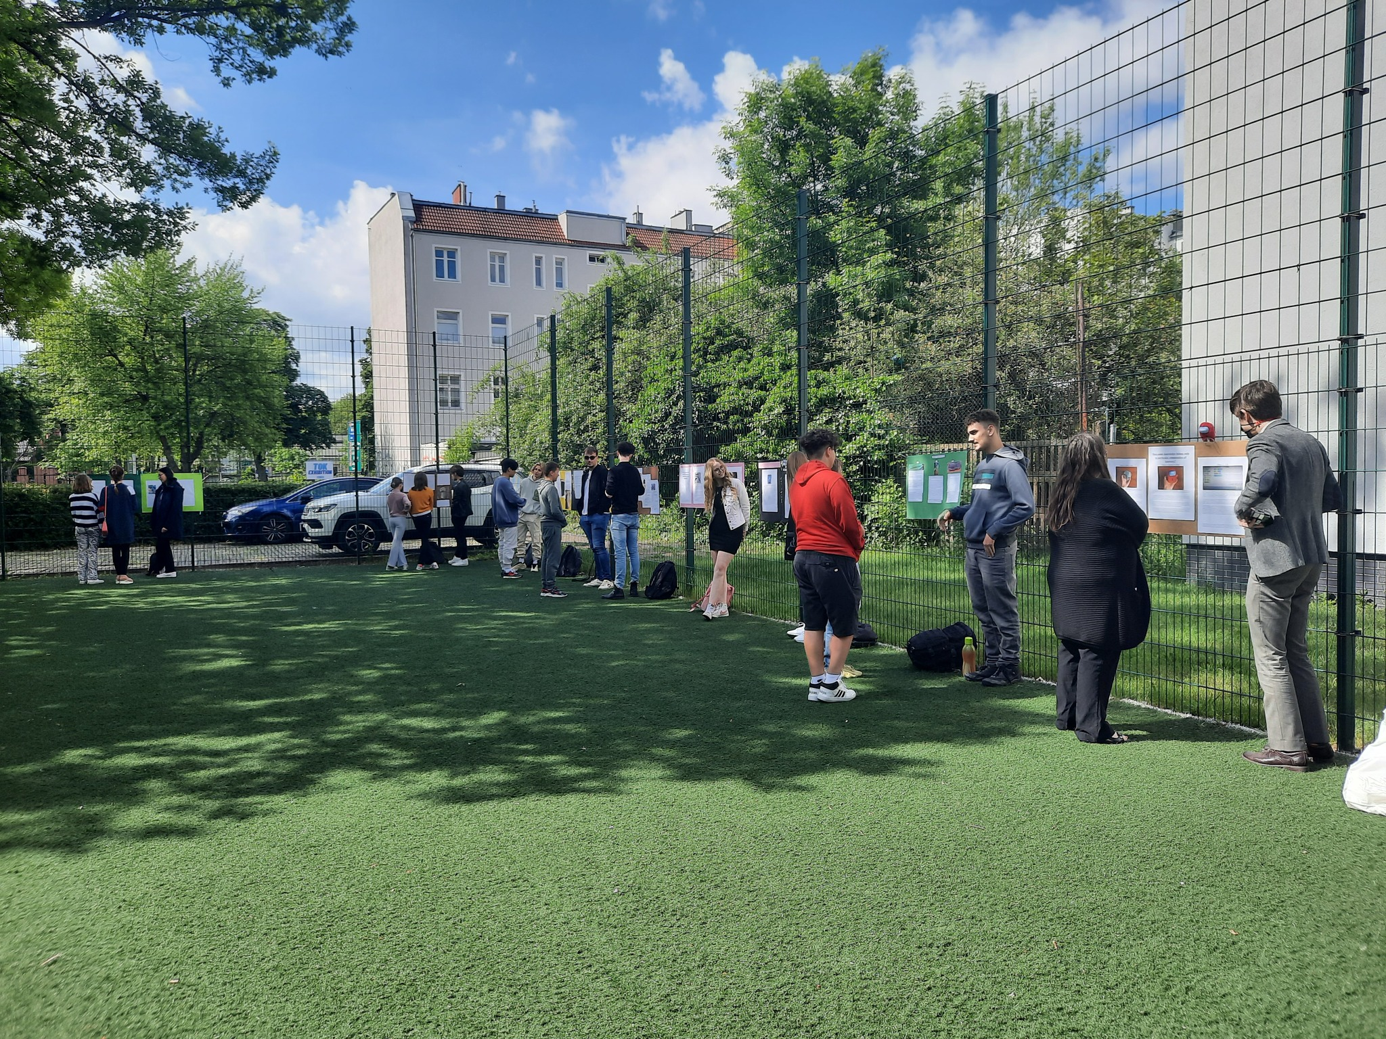
Tok exibition - g11
Organiser: T.Lloyd, Z.Kulik

Slide 27
Kuratorium competition
LAUREACI:
Wiktoria Czeszak Grade 7 - Polish
Evan Bultmann Grade 7 - English
FINALISTS English:
Maria Rocio Rodriguez Ratajczak Grade 7
Emilija Tansill Grade 7
Charles Snowsill Grade 8

Slide 28
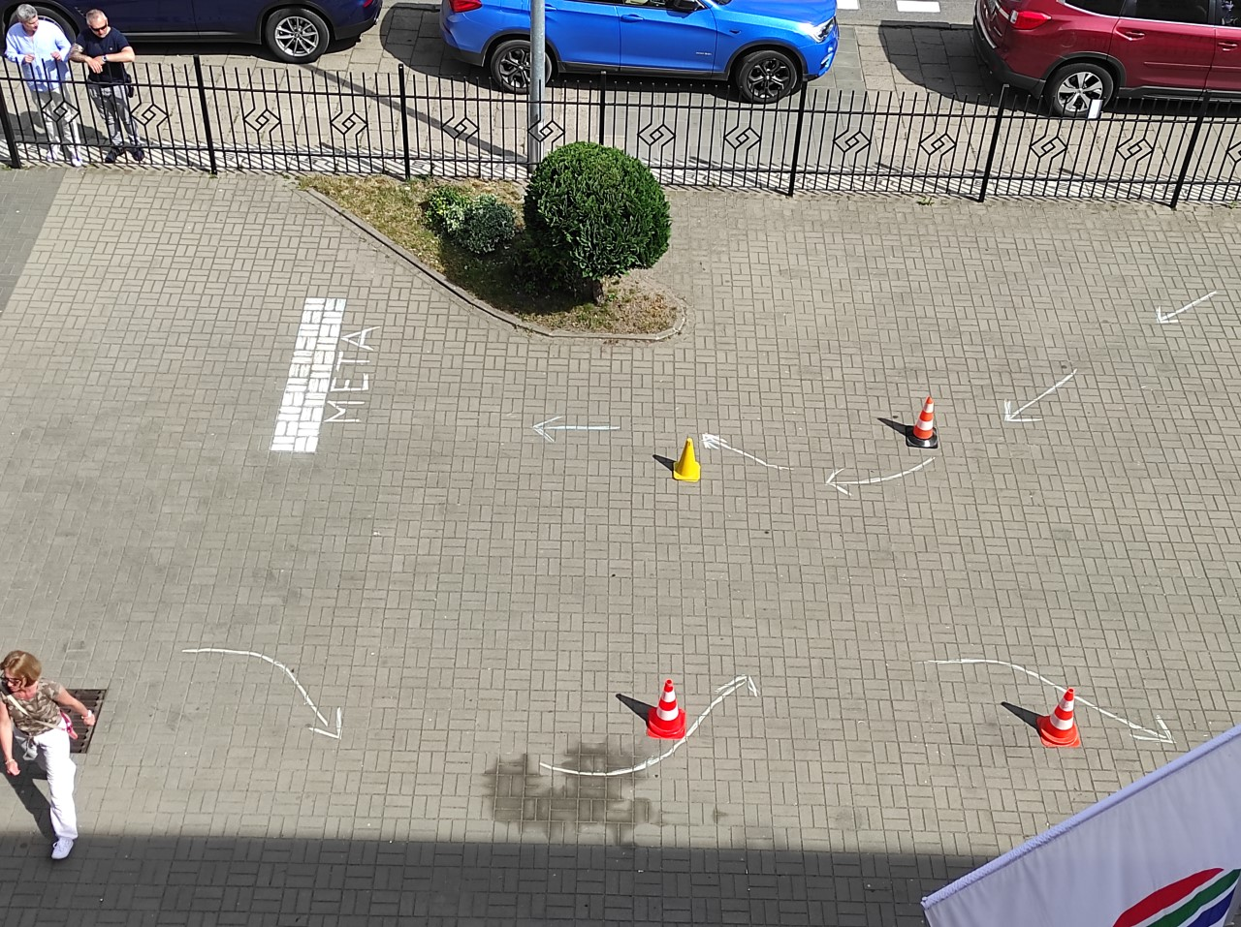
Cycling permit

Slide 29
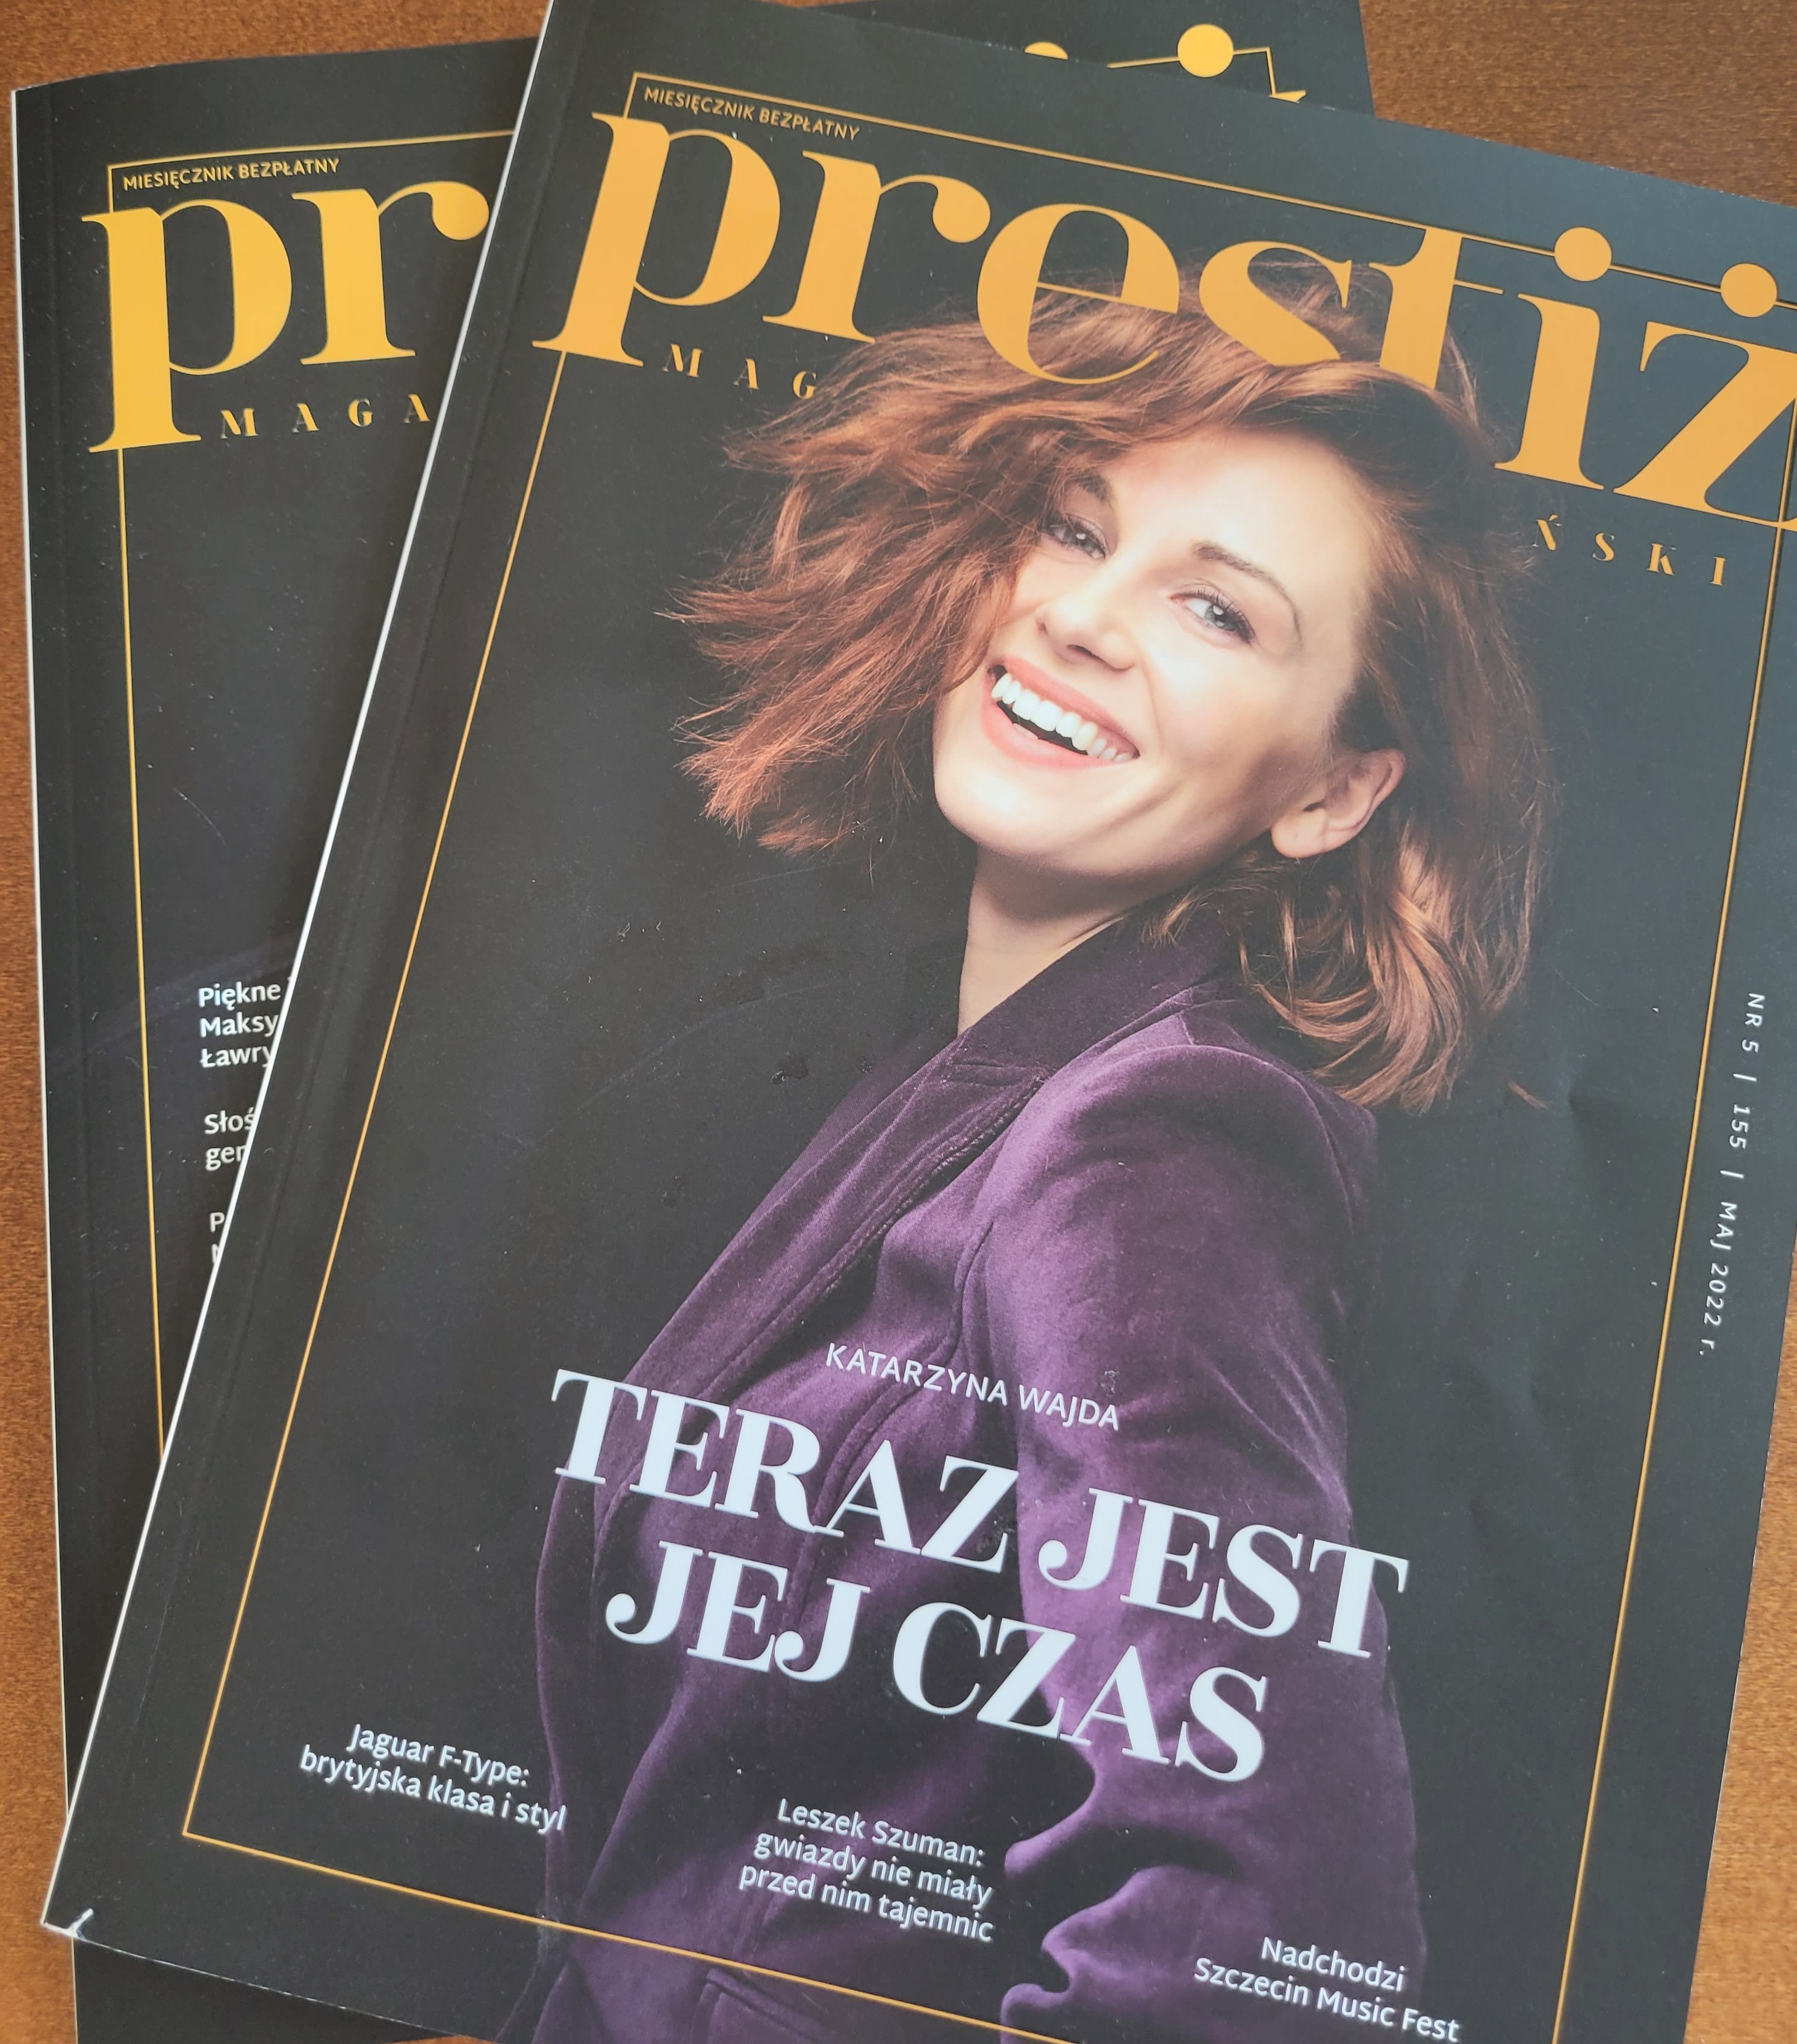
Prestiż magazine interview with d. howlett
E.IWANIUK-BAKALARCZYK

Slide 30
20th anniversary

Slide 31
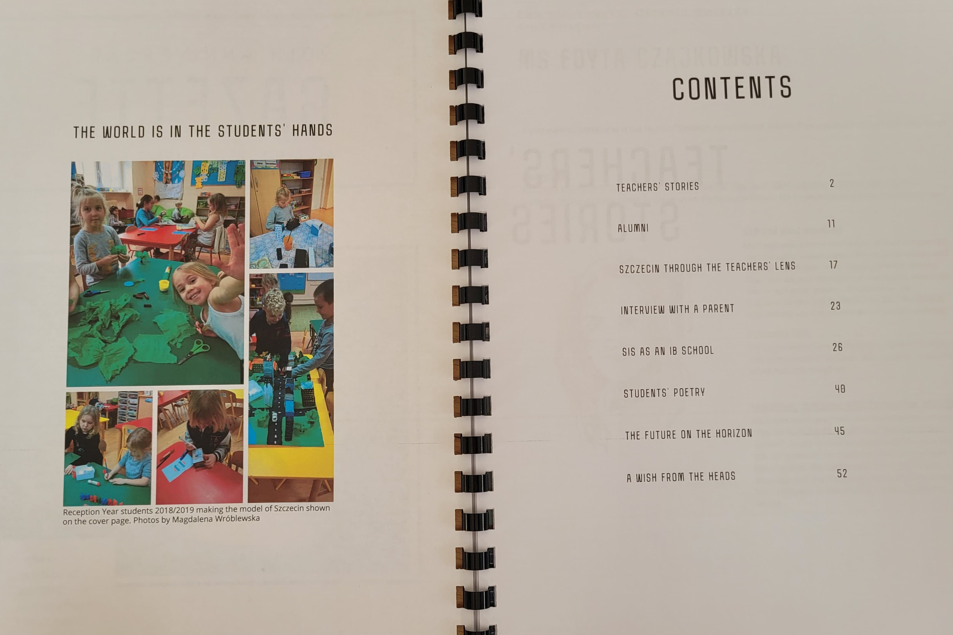
Anniversary gazette
M.WESOŁOWSKA-NOWAK
M.LECHICKA-DZIEL

Slide 32
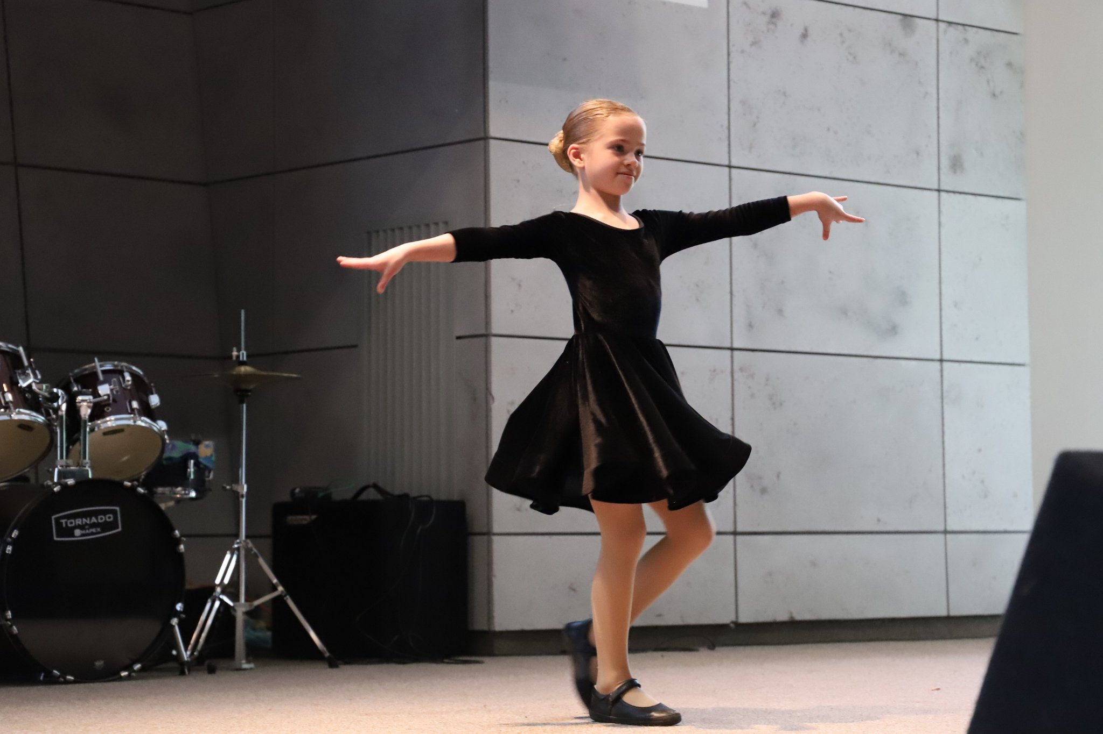
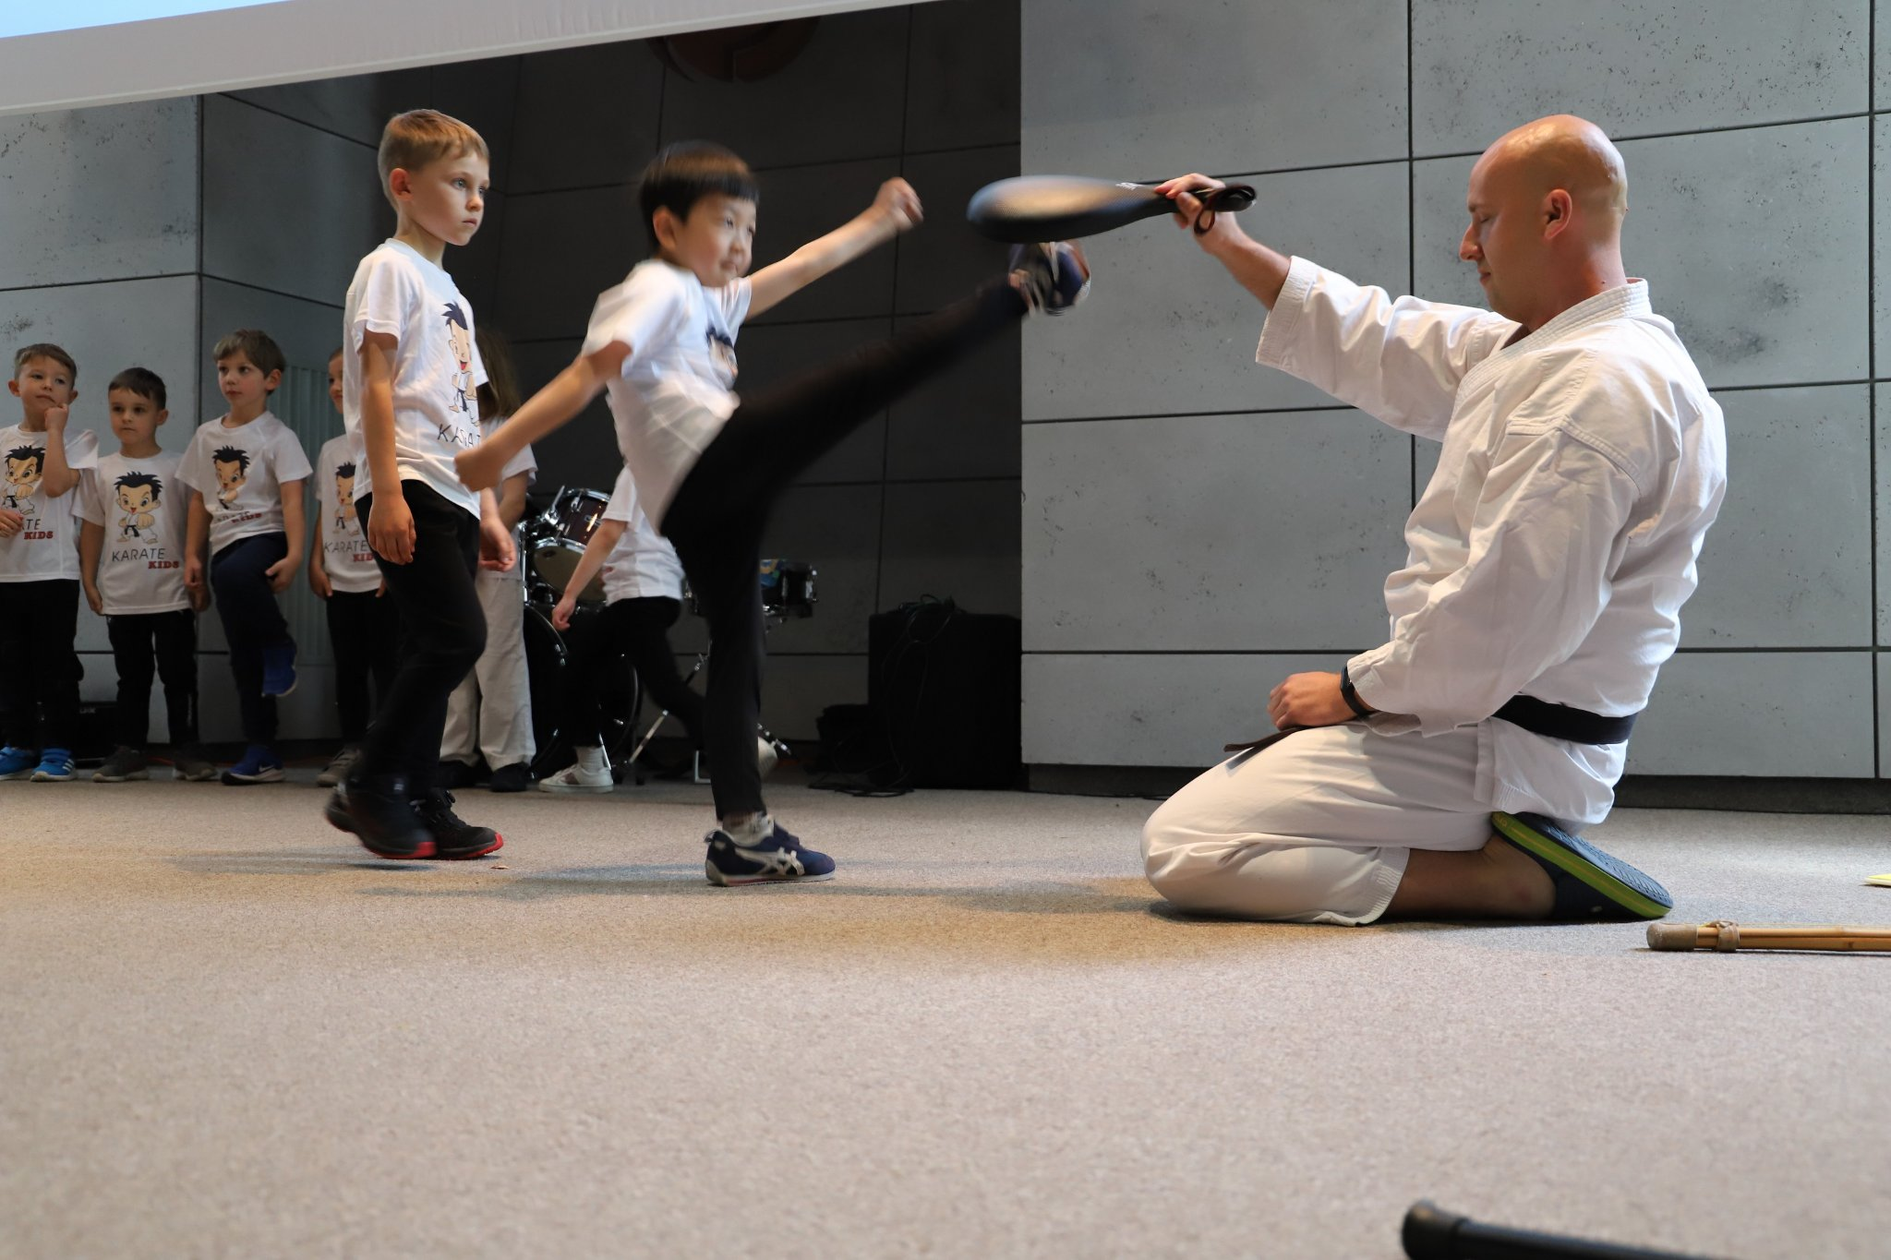
Celebration at zut

Slide 33
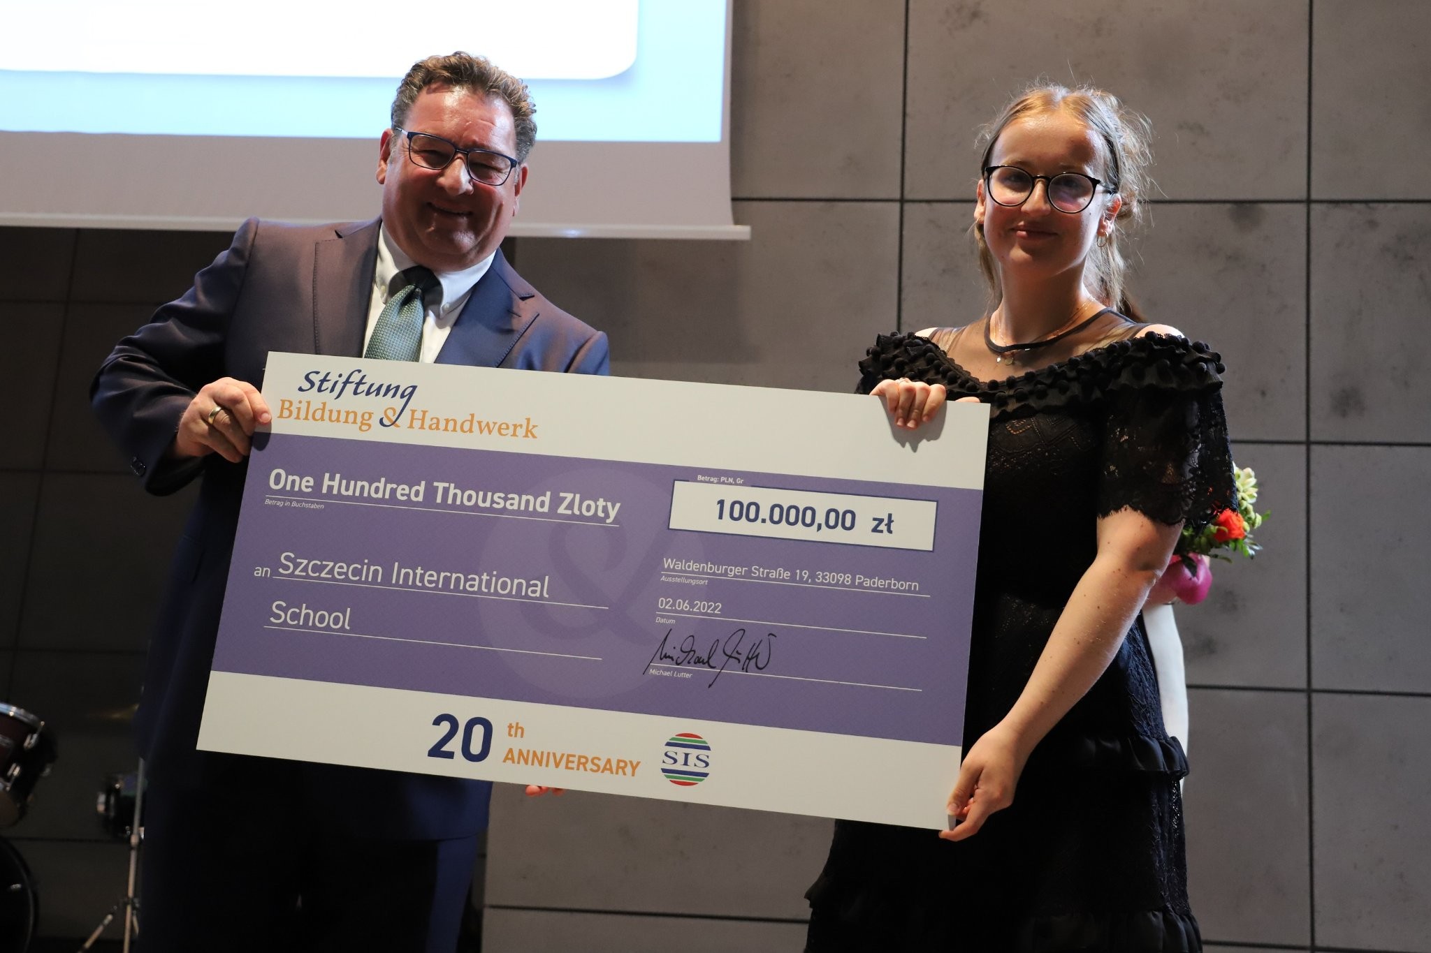
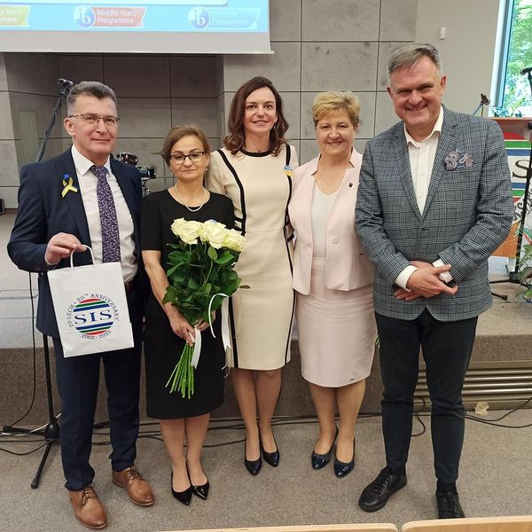
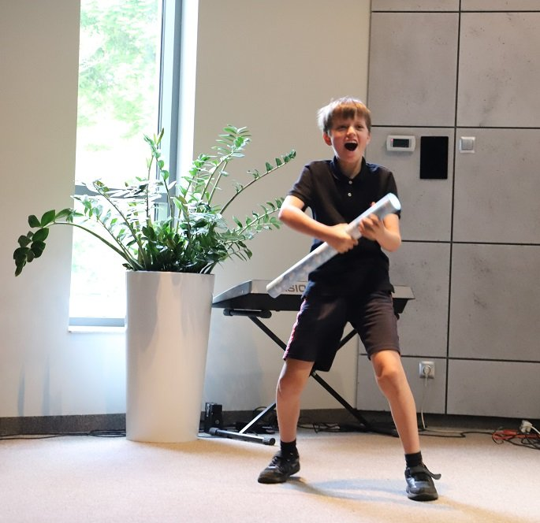

Slide 34
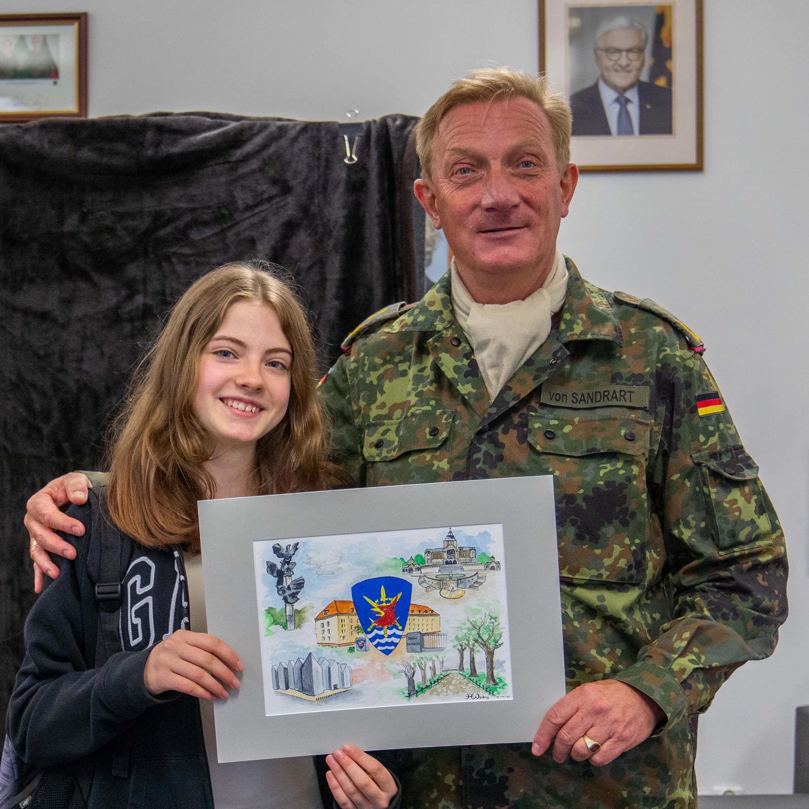
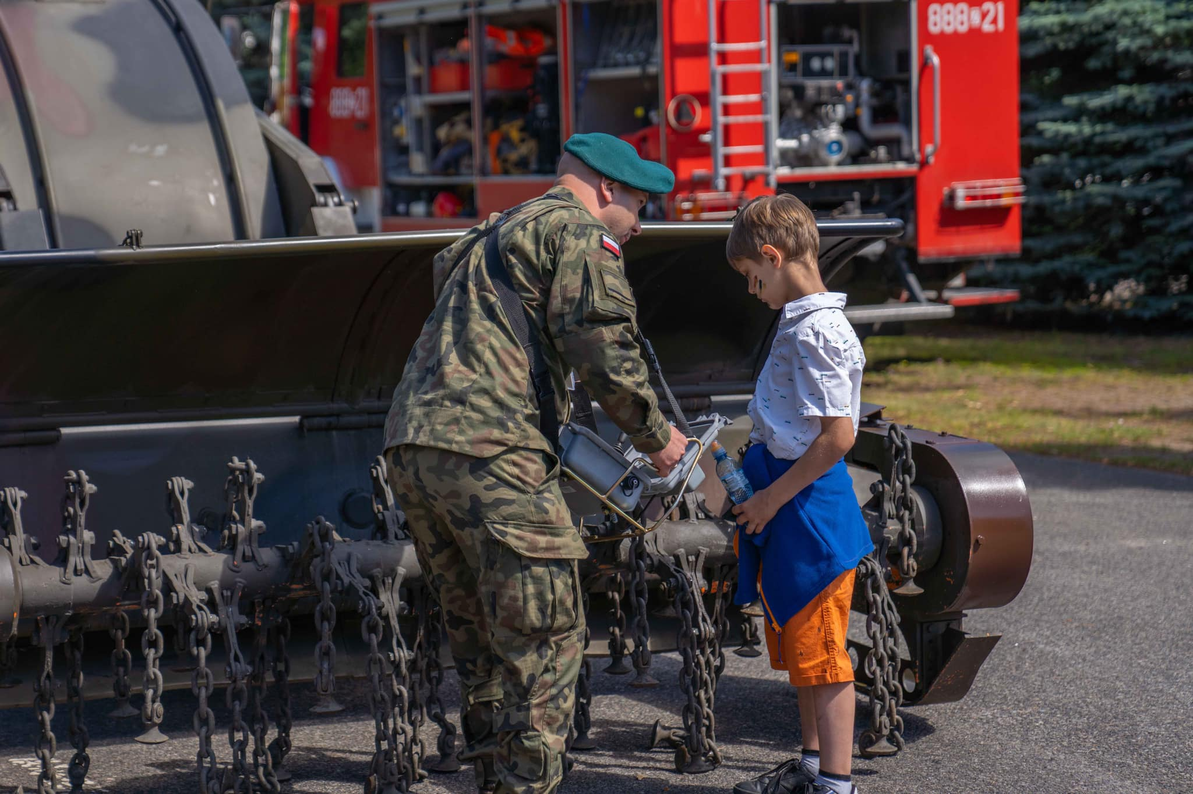
MEETING AT MULTINATIONAL CORPS NORTHEAST
Organiser: K.STüTZ

Slide 35
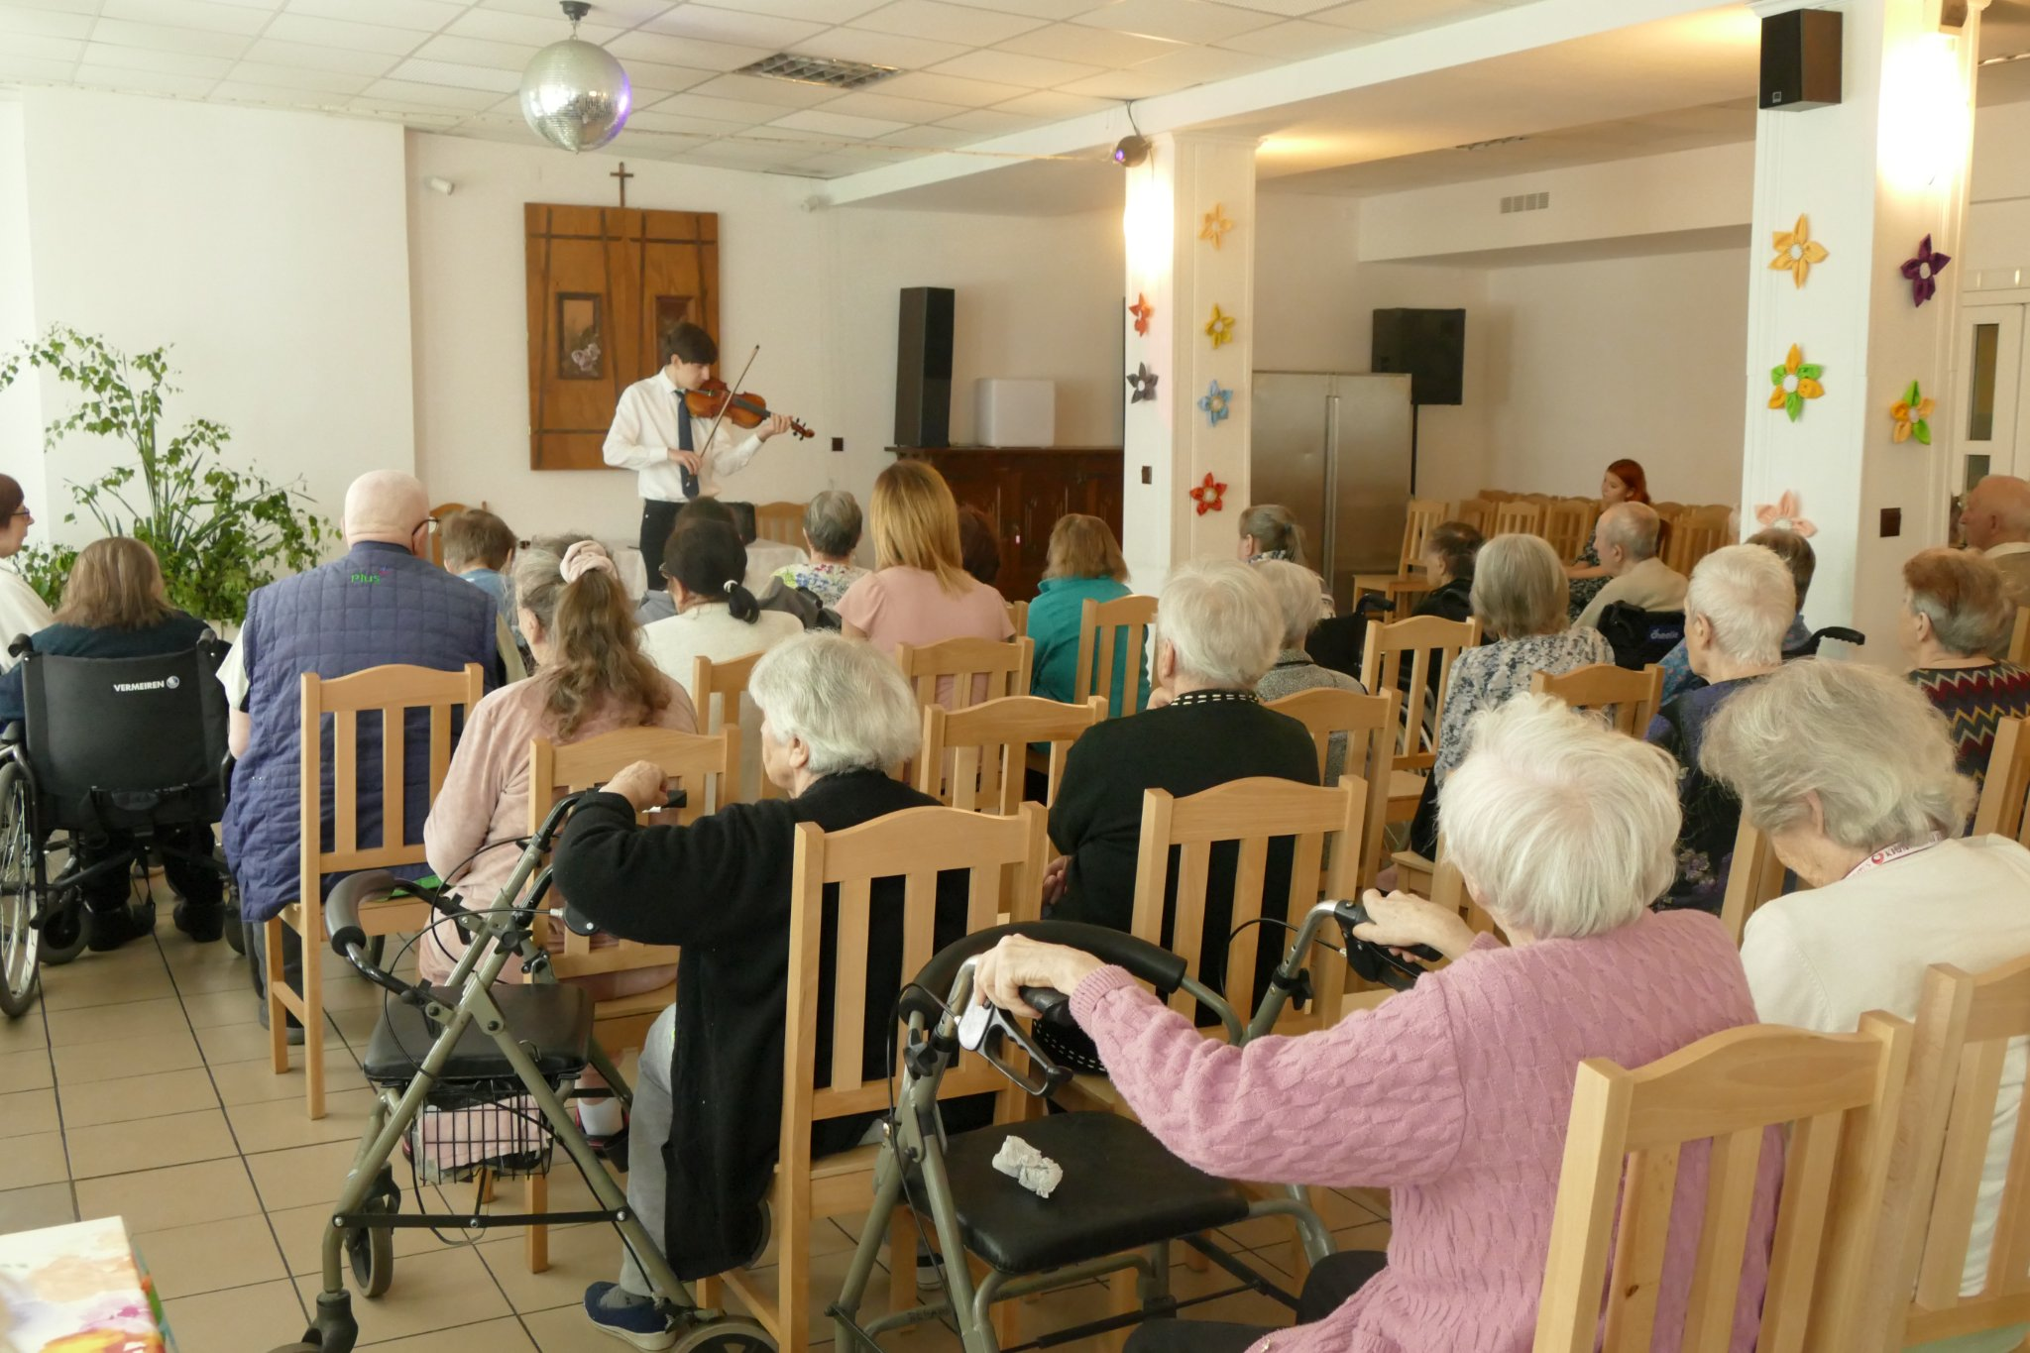
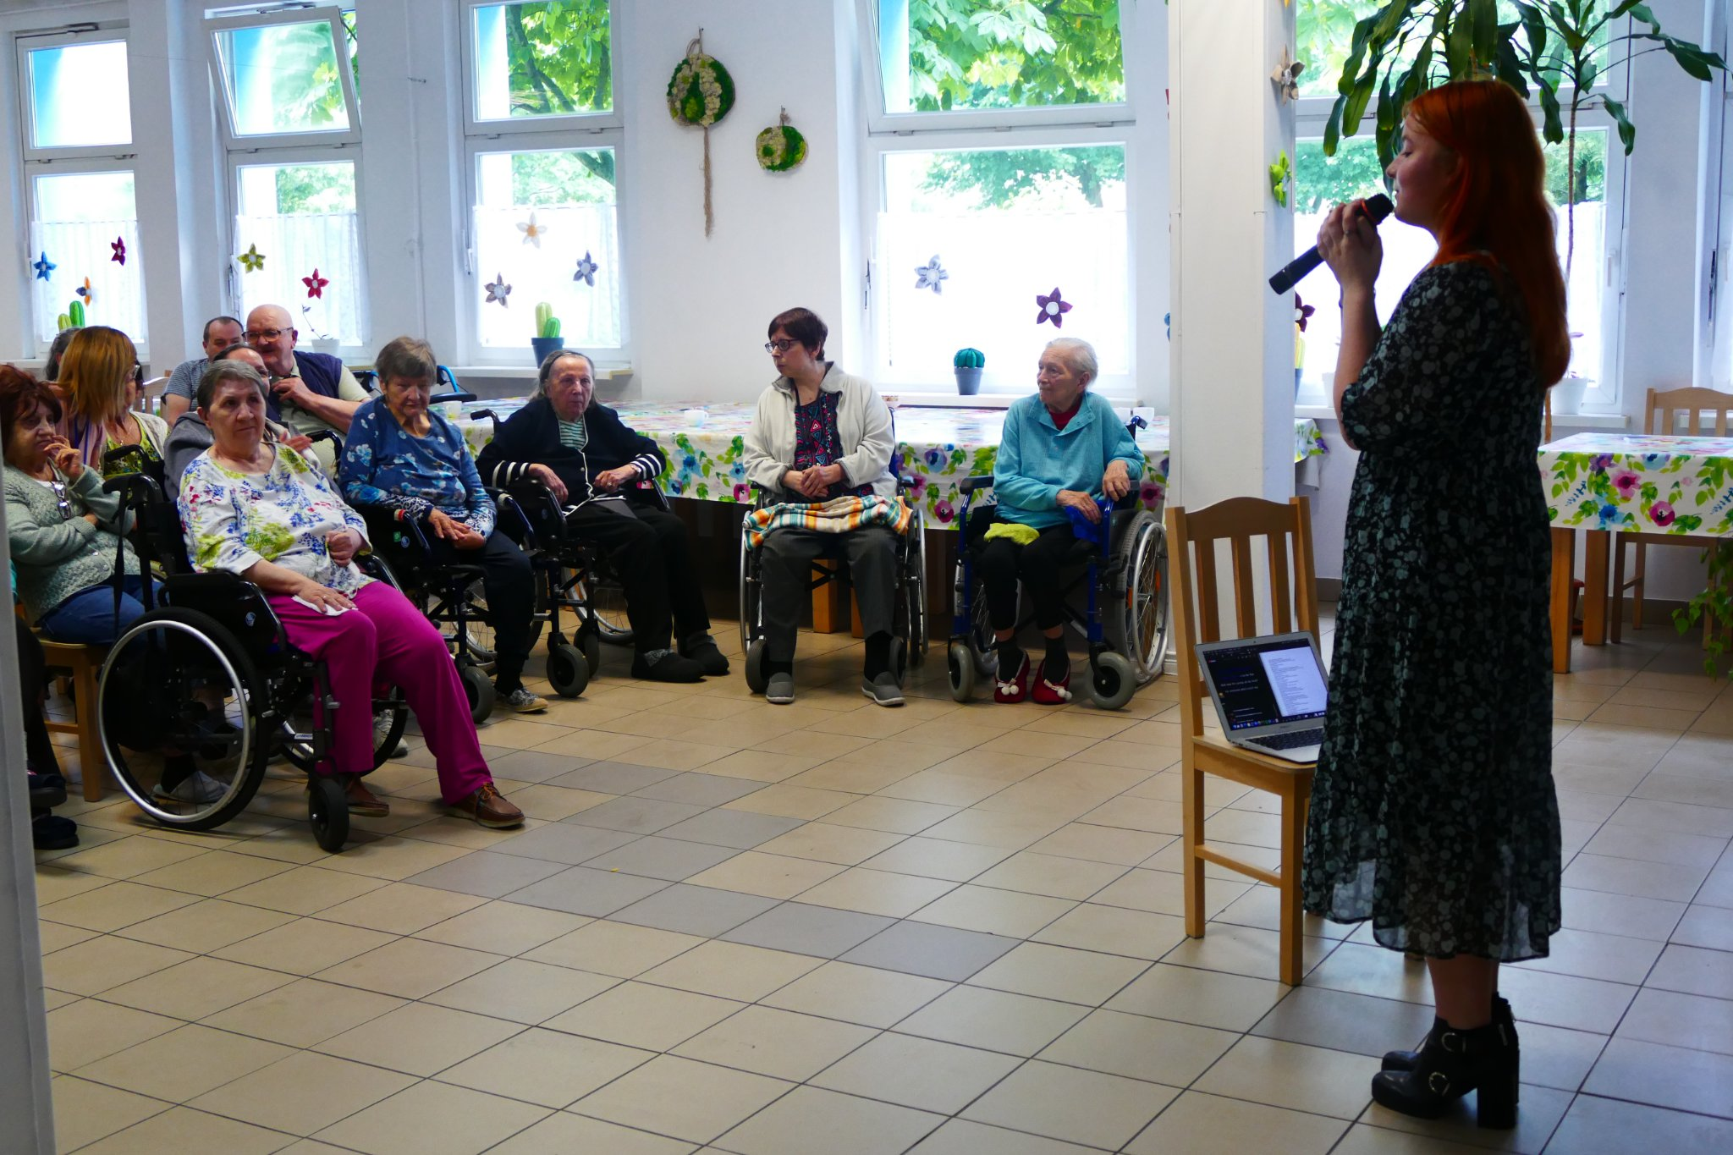
visit at the Nursing Home
Organiser: M.Polakowska

Slide 36
Pyp trip to wrzosowo

Slide 37
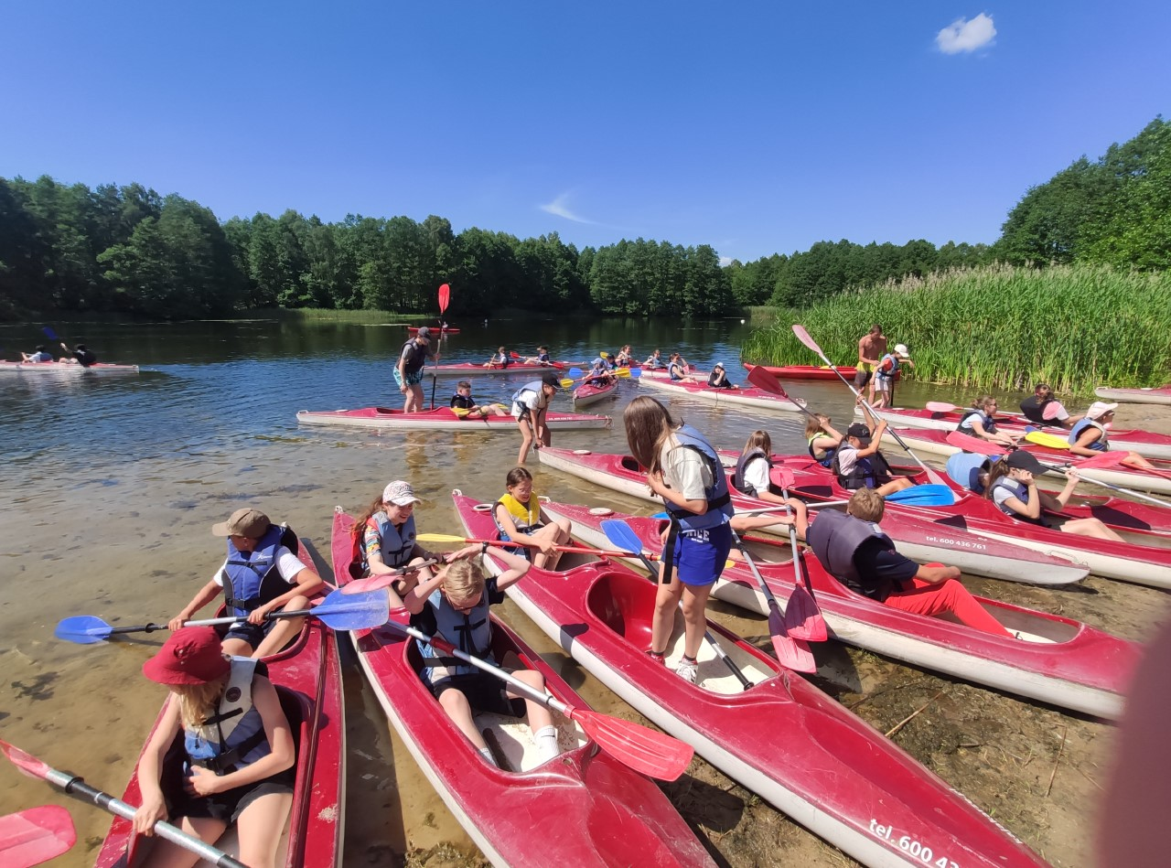
Myp trip to sypniewo
Organiser: J.Dobosz

Slide 38
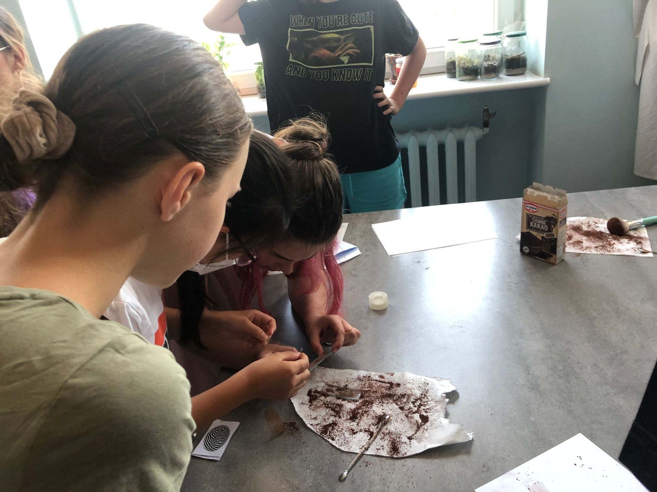
A mystery game
Organiser: T. LLoyd

Slide 39
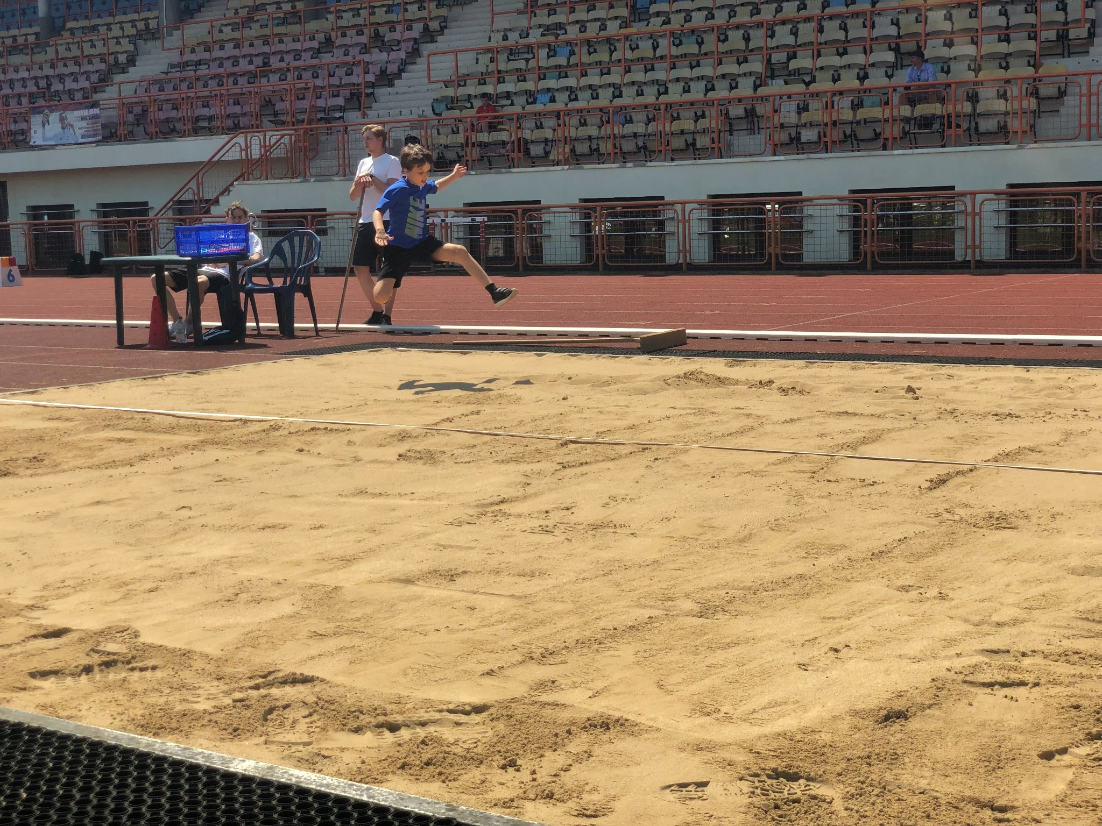
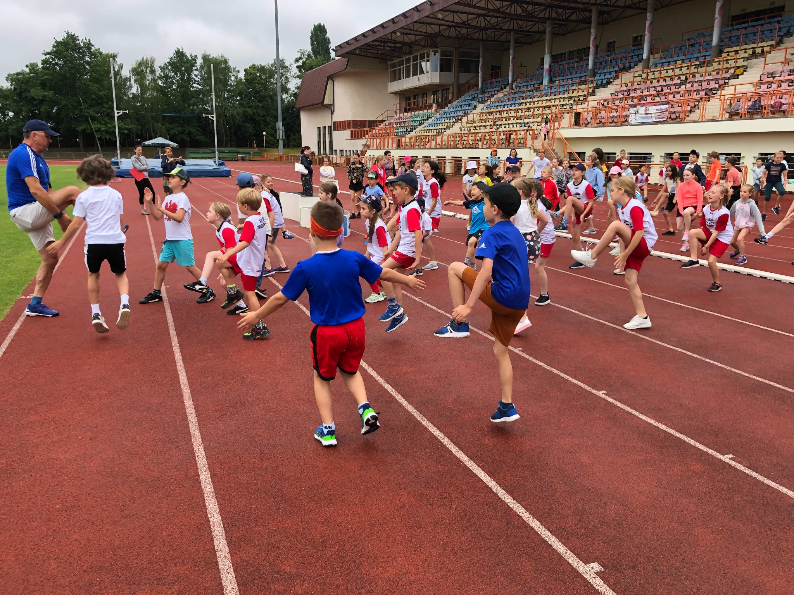
SPORTS DAY pyp
Organisers: C.Janiszyn, A.Witkowska

Slide 40
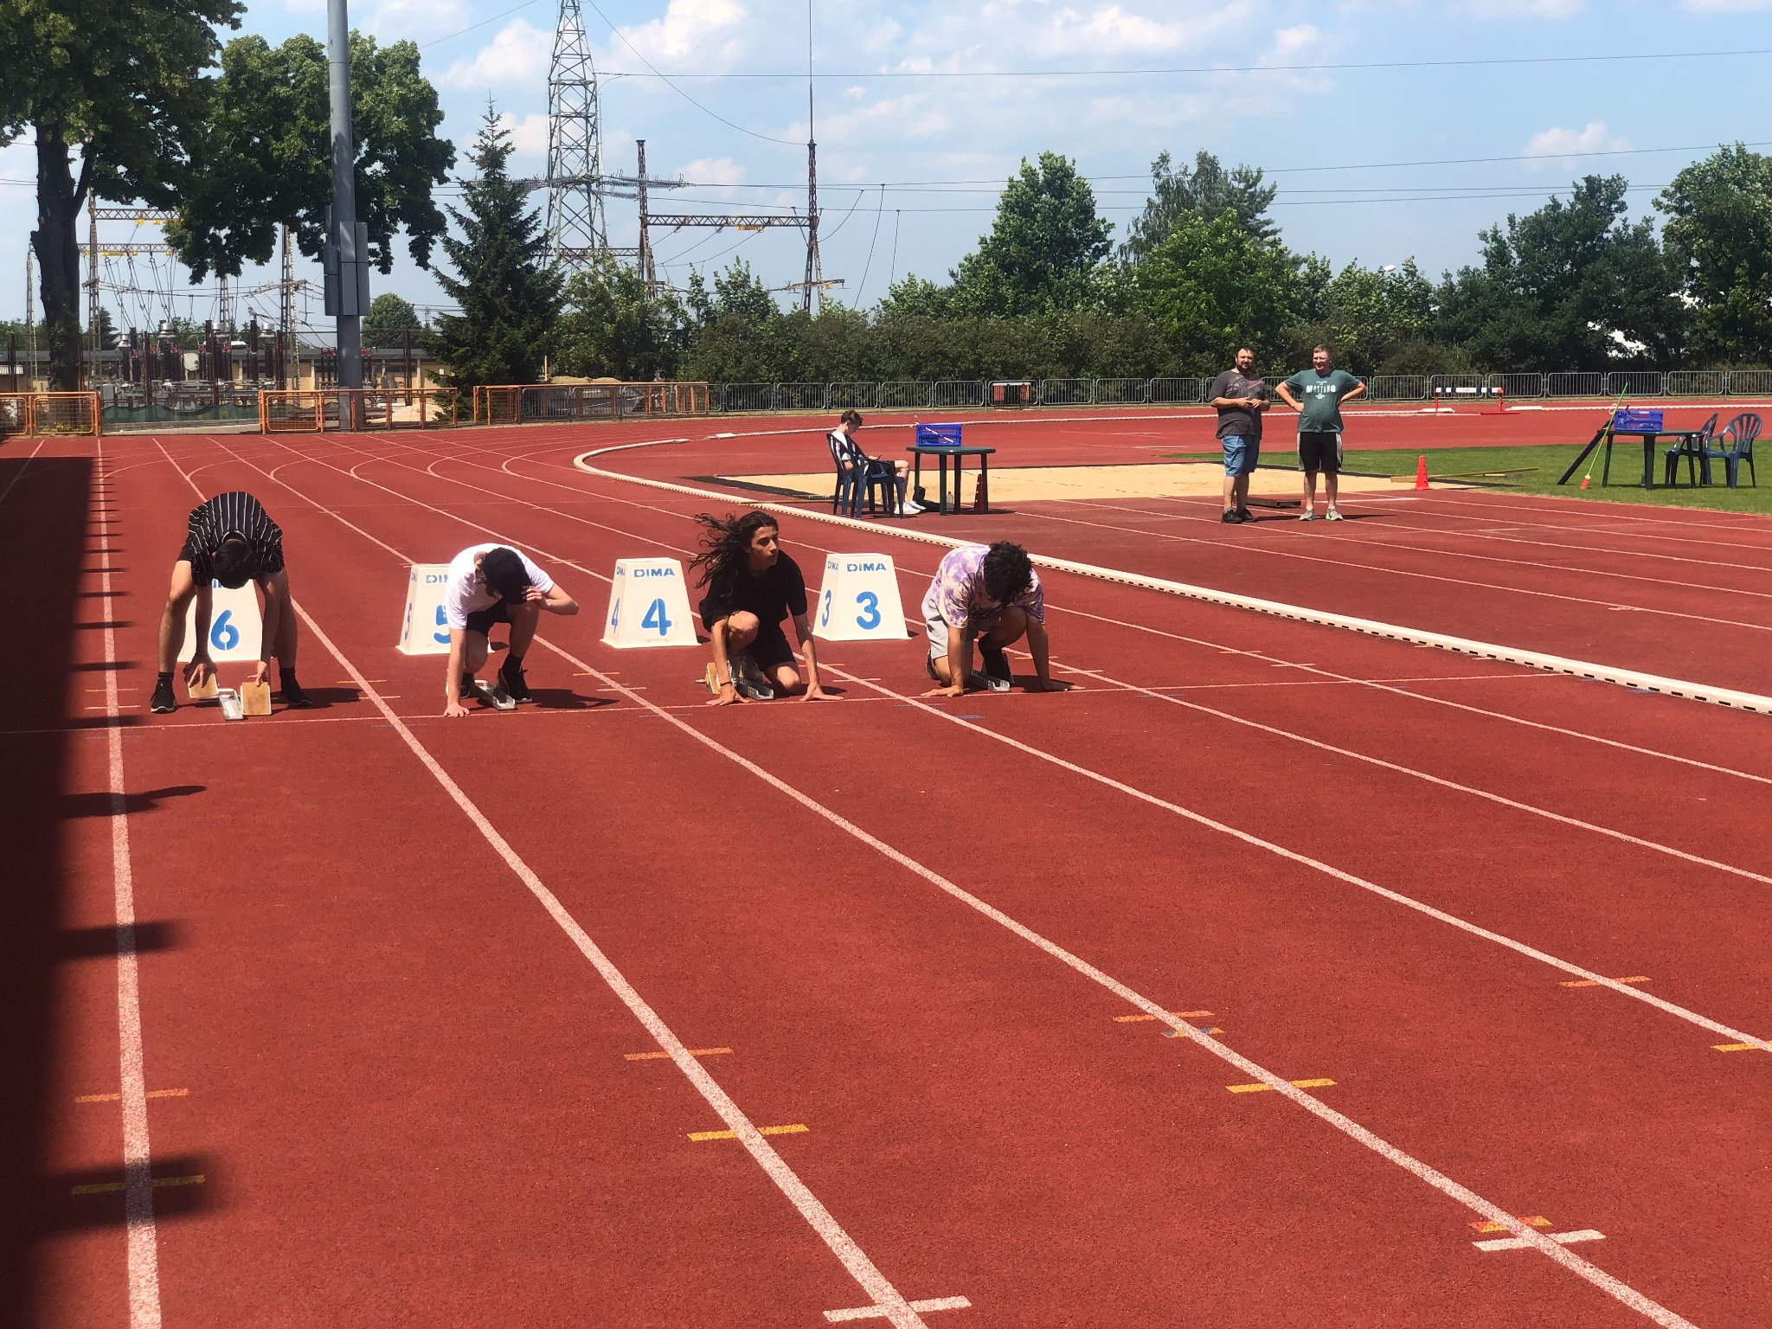
myp

Slide 41
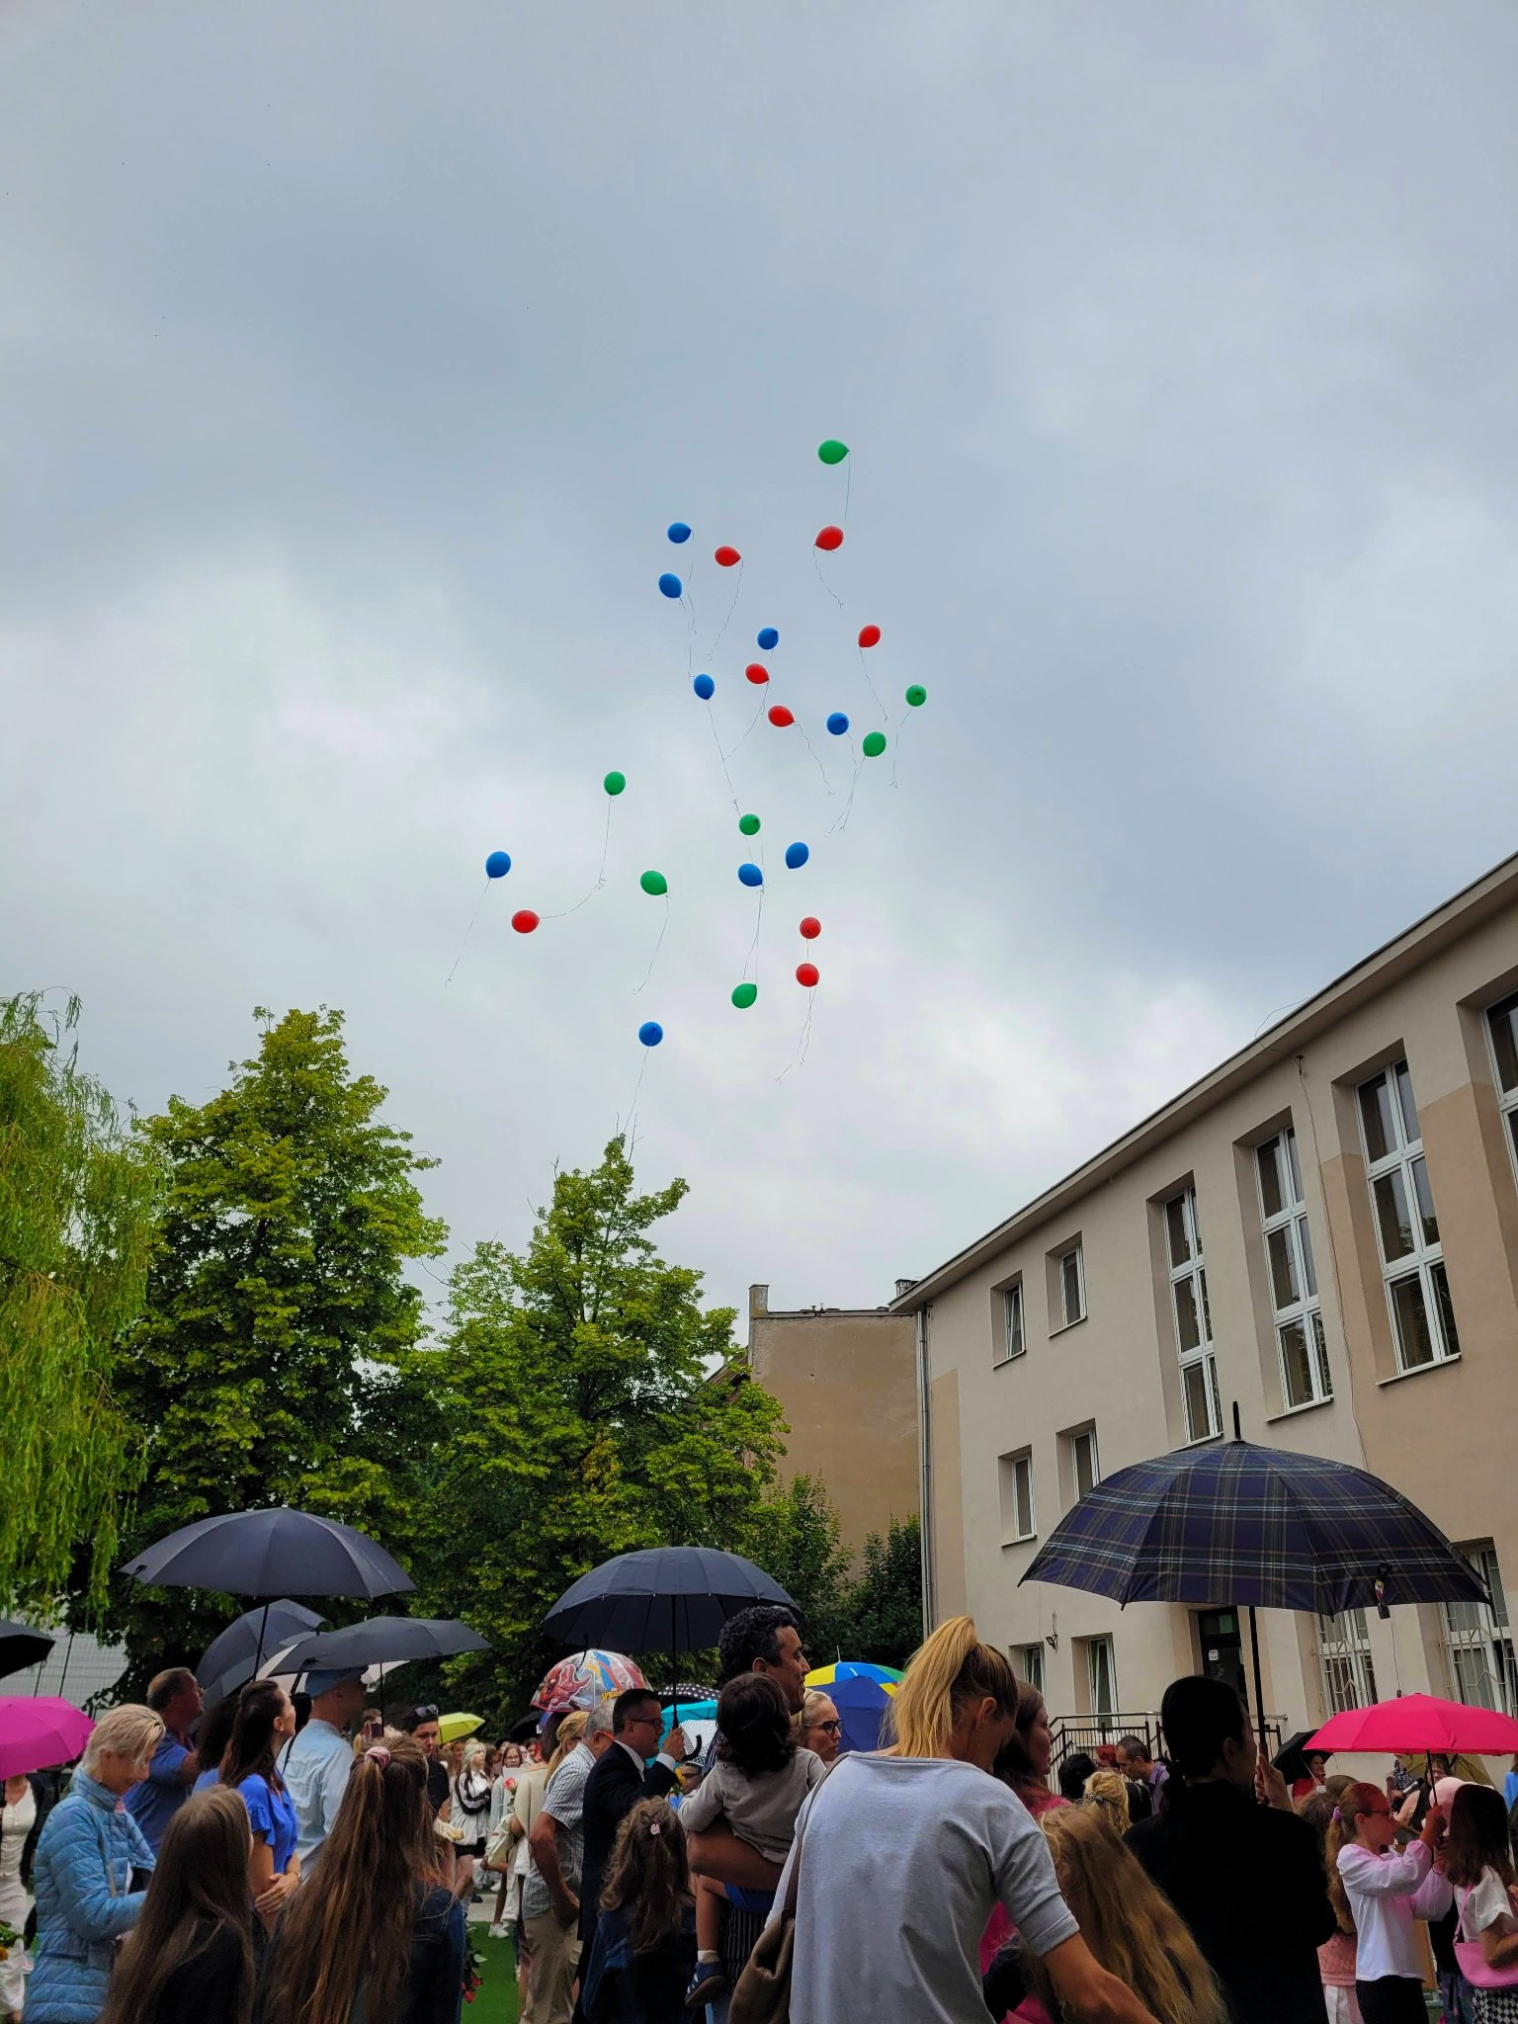
eNd of the school year

